Slide 1
CEN 3078 Computer Security
Module 4 – Defense Architectures and Design

Slide 2
Network Scanning and Vulnerability Scanning
Digital Forensics
Cybersecurity Engineering
Security policies
Firewalls
Authentication, Access controls
Federated trust
IoT/Cloud middleware
Module 4 – Defense Architectures and Design

Slide 3
Network Scanning and Vulnerability Scanning
Digital Forensics
Cybersecurity Engineering
Security policies
Firewalls
Authentication, Access controls
Federated trust
IoT/Cloud middleware
Module 4 – Defense Architectures and Design

Slide 4
Introduction
Any system should be periodically assessed for vulnerabilities
Methods for assessment include:
Vulnerability scanning
Penetration testing
Auditing
Tools are available to scan networks for vulnerabilities
Security procedures can provide a network environment with more secure computing

Slide 5
Basics of Assessing a System
Knowing how to begin securing a system can be daunting
The stages of assessing a system’s security can be categorized into the six Ps:
Patch – check and keep system patches up to date
Ports – shut down any unneeded ports
Protect – implement a firewall and IDS
Policies – enforce written policies on computer security
Probe – regularly probe network for security flaws
Physical – use policies for securing server rooms, individual workstations, and other physical equipment

Slide 6
Securing Computer Systems
Some organizations offer step-by-step guides or security templates for use in your network setting:
National Security Agency
See https://nsacyber.github.io/publications.html
Center for Internet Security (CIS)
See https://www.cisecurity.org
SANS Institute
See www.sans.org/resources/policies/
Templates for implementing security precautions:
Windows security templates
See https://support.microsoft.com/en-us/kb/816585

Slide 7
Securing Computer Systems (cont.)
Securing individual workstations
Apply all patches
Restrict the ability to install programs or alter system settings
Install antivirus and antispyware software
Configure firewalls
Enforce the use of secure passwords
Securing a server
Follow the same steps as for workstations, plus…
Enable operating system logging and review logs periodically
Back up data on a regular basis (daily is preferred); store backup tapes in an offsite location
Uninstall or shut down unneeded services

Slide 8
Securing Computer Systems (cont.)
Securing a network
Secure all computers that comprise the network
Use a firewall, proxy server, and IDS
Partition a large network into smaller segments with a firewall-enabled router between segments
Separate web servers from the rest of the network
The web server should only include operating system and web server software (and optionally, an IDS)
Consider using a DMZ, which involves two firewalls: one outer and one inner (see the next slide)

Slide 9
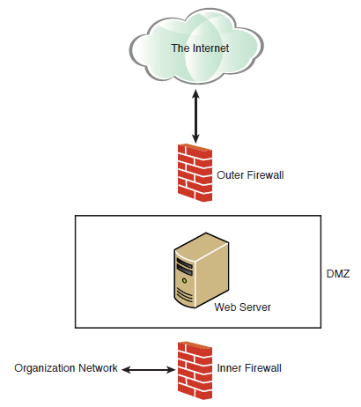
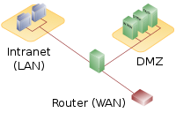
DMZ (Demilitarized Zone)

Slide 10
Scanning Your Network
To keep a network secure, routinely check the network for vulnerabilities and flaws
Common vulnerability scanners include:
NESSUS – the premiere network vulnerability scanner
OWASP Zap – the standard for web application vulnerability
Shodan – used by black hat hackers and security professionals
Kali Linux – Linux distribution with open-source tools for cybersecurity, digital forensics, and penetration testing
Vega – free, open-source scanner for web applications
OpenVAS – open-source vulnerability scanner that includes several services and tools

Slide 11
Testing and Scanning Standards
There are specific standards that relate to vulnerability scans and penetration tests
Common testing and scanning standards include:
NIST 800-115 – general guide for testing and assessment
NSA-IAM – excellent guide for penetration tests
PCI DSS – standard used by major credit card companies
National Vulnerability Database
U.S. government repository of vulnerability data
Uses the Security Content Automation Protocol (SCAP)

Slide 12
Getting Professional Help
If it’s necessary to hire outside help to set up and test your system’s security, consider these guidelines for finding a qualified individual:
Certification
CNE, MCITP, CISSP, Security+, CASP, GAIC, Cisco, and others
Education
Degree in computer science, engineering, computer information systems, or security
Experience
Minimum of 5 years IT experience, with 2 years security
Background Checks
References, credit check, criminal background check

Slide 13
Summary
Periodically assess a network or system for security vulnerabilities
Weekly for high-security sites
Quarterly for noncritical or low-security sites
Safe computing involves securing all computers, networks, and servers, and using common sense on the Web
Apply security practices and standards to all aspects of network systems

Slide 14
Network Scanning and Vulnerability Scanning
Digital Forensics
Cybersecurity Engineering
Security policies
Firewalls
Authentication, Access controls
Federated trust
IoT/Cloud middleware
Module 4 – Defense Architectures and Design

Slide 15
Digital Forensics - Objectives
Understand basic forensics principles
Make a forensic copy of a drive
Use basic forensics tools
Prepare a forensics report
Avoid common forensics mistakes

Slide 16
Introduction
The network administrator is often the first responder to a computer crime
Evidence must be handled properly, or it could be rendered unusable in a court
Computer forensics has evolved only in the past 20 to 30 years
Computer forensics is also called cyber forensics
The goal of cyber forensics is to examine computer devices using scientific methods to extract evidence that can be presented in court

Slide 17
General Guidelines
Don’t touch the suspect drive
Use Linux commands to make a forensically valid copy of a drive
Imaging a drive with Forensic Toolkit
Commercial product; can be expensive
FTK Imager is a free download
Another option is OSForensics
Imaging a drive is preferred to live forensics

Slide 18
General Guidelines (cont.)
Document trail
In a forensics investigation, document everything
Events, who was present, what they were doing, etc.
Secure the evidence
Take the computer offline
Limit access to the machine
Chain of custody
Who had access to evidence
How they interacted with evidence
Where the evidence was stored

Slide 19
General Guidelines (cont.)
FBI Forensics Guidelines
Beyond the general guidelines, another step is to document specific losses
Labor cost spent in response and recovery
Cost of equipment, if damaged
Value of data, if any was lost or stolen
Lost revenue due to downtime, customer credit, etc.
Computer evidence includes:
Logs
Portable storage devices
Emails
Devices capable of storing data
Cell phones

Slide 20
General Guidelines (cont.)
U.S. Secret Service Forensics Guidelines
Another federal agency tasked with combating cybercrime
“Golden rules” for first responders in an investigation
Secure the scene; make it safe
Take immediate steps to preserve the evidence
Do you have a legal basis to seize the computer?
Avoid accessing computer files
Properly shut down the computer if it is on; pull the power cord if you think the computer is destroying evidence
Take pictures of the computer screen, location, etc.
Determine whether special legal considerations apply

Slide 21
General Guidelines (cont.)
Standards
A wide range of industry standards relate to digital forensics
These standards include:
SWGDE
ASCLD
RFC 3227
ISO/IEC 27037:2012
ISO/IEC 27041
ISO/IEC 27042
ISO/IEC 27043
ISO/IEC 27050

Slide 22
General Guidelines (cont.)
Forensics reports
Should be sufficiently detailed with screenshots and logs
A basic outline should include: Your qualifications, what exactly you did, why you did that, and conclusions
Tools for conducting forensic analysis include:
FTK
EnCase
OSForensics
Magnet Forensics
Sleuth Kit
Oxygen
Cellebrite

Slide 23
Finding Evidence on a PC
Finding Evidence in a Browser
The browser can be a source of direct evidence and circumstantial or supporting evidence
The browser might contain direct evidence of the specific crime, such as cyber stalking
If you suspect someone created a virus that infected a network, you might only find indirect evidence
If the history is erased, it is still possible to retrieve it
Windows stores a lot of information in a file named index.dat
Most forensics tools can extract evidence from a computer

Slide 24
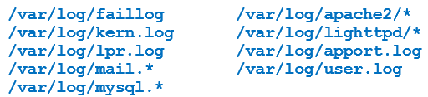
Finding Evidence in System Logs
Operating systems store information in system logs
Check for these logs in Windows:
Security log
Application log
System log
ForwardedEvents log
Applications and Services logs
Check for these logs in Linux:

Slide 25
Getting Back Deleted Files
Criminals often attempt to destroy evidence
There are a variety of tools that can recover files, especially in Windows
Forensic tools that can recover deleted files include:
AccessData FTK
OSForensics
EnCase
DiskDigger

Slide 26
Operating System Utilities
Operating system utilities can be helpful when gathering forensic data
OS utilities in Windows include:
net sessions
openfiles
fc
netstat

Slide 27
The Windows Registry
The Registry is the heart of the Windows machine
A repository of potentially valuable forensics information
Organized into five sections, called hives:
HKEY_CLASSES_ROOT (HKCR)
HKEY_CURRENT_USER (HKCU)
HKEY_LOCAL_MACHINE (HKLM)
HKEY_USERS (HKU)
HKEY_CURRENT_CONFIG (HCU)
Most people use the regedit tool to work with the Registry

Slide 28
Mobile Forensics: Cell Phone Concepts
Document the state of the cell phone
Nascent state/factory default
Active state
Semi-active state
Quiescent state
Cell phone components
Subscriber identity module (SIM)
International mobile subscriber identity (IMSI)
Integrated circuit card identification (ICCID)
International mobile equipment identity (IMEI)

Slide 29
Mobile Forensics: Cell Phone Concepts (cont.)
Cell phone networks are based on radio towers
Cell tower base stations consist of an antenna and radio equipment
Different types of cellular networks include:
Global System for Mobile Communications (GSM)
Enhanced Data Rates for GSM Evolution
Universal Mobile Telecommunications Systems
Long Term Evolution
5G
Integrated Digitally Enhanced Network (iDEN)

Slide 30
The Need for Forensic Certification
Certification should indicate that the holder of that certification has met a minimum standard
Indicates competence, not necessarily mastery
Certifications include:
AccessData (Forensic Toolkit)
Guidance Software (EnCase)
Certified Hacking Forensics Investigator (CHFI)
SANS Institute:
Certified Forensics Analyst (GCFA)
Certified Forensics Examiner (GCFE)

Slide 31
Expert Witnesses
Allowed to testify about things not seen or heard
Allowed to make inferences and formulate theories
Testimony is governed by rules such as:
Federal Rule 702
Defines what an expert witness is
Defines rules about when she can testify and what she can testify to
Daubert
Standard used in U.S. federal courts
Determines whether an expert’s scientific testimony is based on reasoning or scientifically valid methodology

Slide 32
Additional Types of Forensics
Computer and phone forensics are the most widely encountered
Other subdisciplines of digital forensics include:
Network forensics
Involves capturing the network packets traversing the network and examining them for evidence
Popular tools: Wireshark, CommView, ngrep
Virtual forensics
Virtualization provides IT resources that are independent of the physical machinery of the user
Virtual machines; public, private, and community clouds

Slide 33
Summary
Always make a forensics copy to work with
Document everything in an investigation
Retrieve browser information and recover deleted files
Use commands helpful for forensic analysis
The Windows Registry and the cloud can add value to forensic analysis

Slide 34
Network Scanning and Vulnerability Scanning
Digital Forensics
Cybersecurity Engineering
Security policies
Firewalls
Authentication, Access controls
Federated trust
IoT/Cloud middleware
Module 4 – Defense Architectures and Design

Slide 35
Objectives
Understand basic systems engineering concepts
Understand how to integrate systems engineering into cybersecurity
Utilize engineering tools in cybersecurity
Explain the use of standards in cybersecurity engineering

Slide 36
Introduction
The field of cybersecurity is growing rapidly
Presents challenges for defining the profession
Many different approaches are used in cybersecurity and cybersecurity education
Practiced as a business management discipline
Approached as a computer science sub-discipline
Wide range of technical backgrounds and skill sets for practitioners
Cybersecurity can be viewed as an engineering discipline—a sub-discipline of systems engineering

Slide 37
Defining Cybersecurity Engineering
Cybersecurity and Systems Engineering
Cybersecurity involves diverse computer systems, human processes, operating systems, and more
Cybersecurity could be considered a sub-discipline of systems engineering
Systems engineering is concerned with a given system, or system of systems, throughout the system life cycle
Begins with the concept phase and continues through system disposal
This is an appropriate approach for cybersecurity engineering

Slide 38
Defining Cybersecurity Engineering
Applying Engineering to Cybersecurity
A cybersecurity project should begin by defining the requirements
Use the SMART acronym for effective requirements:
Specific
Measurable
Achievable
Realistic
Timely
A tool to aid in planning is the Work Breakdown Structure (WBS), which breaks a project into smaller tasks; see the next slide for an example

Slide 39
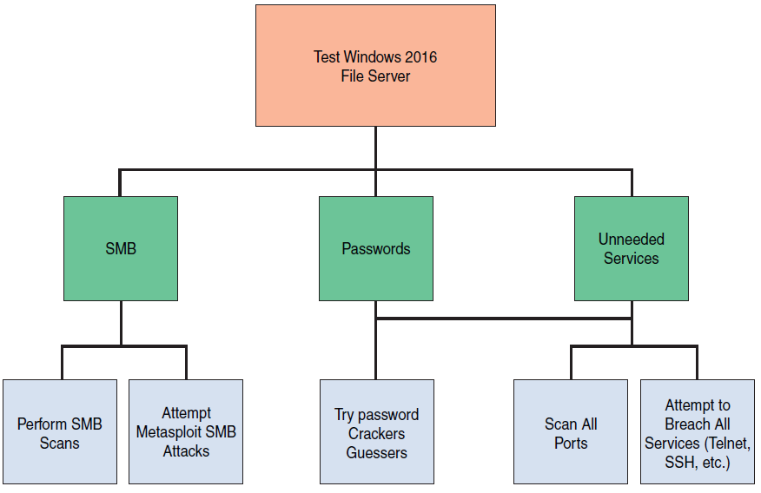
Work Breakdown Structure
Notes:
SMB – Server Message block

Slide 40
Standards
Every engineering discipline has specific standards
Standards in the cybersecurity industry include:
RMF: Guide for Applying the Risk Management Framework
ISO 27001: Standard for Information Security Management System (ISMS)
ISO 27004: How to Measure Information Security
NIST SP 800-63B: Digital Identity Guidelines

Slide 41
Modeling
Cybersecurity engineering is directed toward some threat
Modeling ensures you are building your security to counter the threats specific to your systems
Different modeling concepts include:
STRIDE: Identifies threats in six categories
PASTA: Risk-centric seven-step methodology
DREAD: Mnemonic for risk rating using five categories

Slide 42
Summary
There are various applications of systems engineering to cybersecurity
The goal is to apply a methodical, systematic approach to cybersecurity
Penetration testing should be a carefully engineered process mapped to specific testing requirements
It is beneficial to model cybersecurity scenarios to better understand system security requirements

Slide 43
Network Scanning and Vulnerability Scanning
Digital Forensics
Cybersecurity Engineering
Security policies
Firewalls
Authentication, Access controls
Federated trust
IoT/Cloud middleware
Module 4 – Defense Architectures and Design

Slide 44
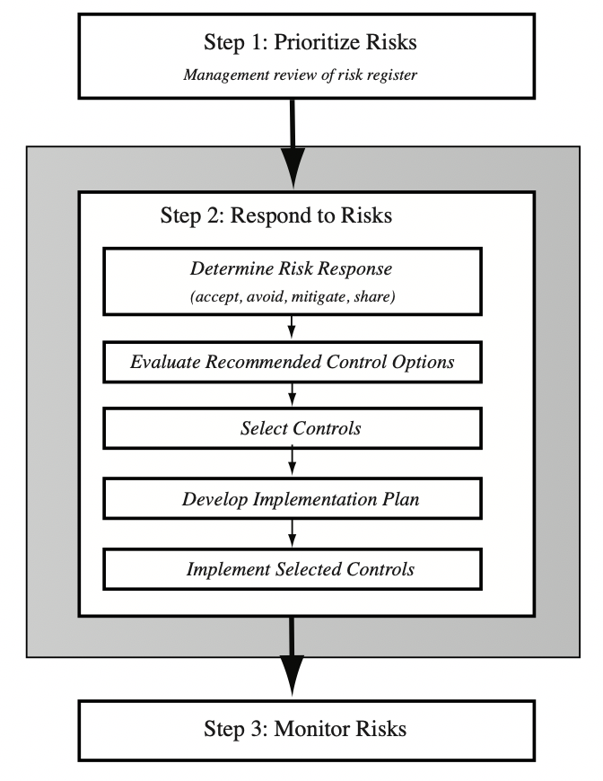
IT Security Management Controls

Slide 45
Security Control
Control is defined as:
“An action, device, procedure, or other measure that reduces risk by eliminating or preventing a security violation, by minimizing the harm it can cause, or by discovering and reporting it to enable corrective action.”
Notes:
A risk assessment on an organization’s IT systems identifies areas needing treatment.
The next step, as shown in Figure 14.1 on risk analysis options, is to select suitable
controls to use in this treatment. An IT security control, safeguard, or countermeasure
(the terms are used interchangeably) helps to reduce risks. We use the following
definition:
“ An action, device, procedure, or other measure that reduces risk by eliminating or preventing a
security violation, by minimizing the harm it can cause, or by discovering and reporting it to enable corrective action.”

Slide 46
Control Classifications
Management controls
Focus on security policies, planning, guidelines, and standards that influence the selection of operational and technical controls to reduce the risk of loss and to protect the organization’s mission
These controls refer to issues that management needs to address
Operational controls
Address the correct implementation and use of security policies and standards, ensuring consistency in security operations and correcting identified operational deficiencies
These controls relate to mechanisms and procedures that are primarily implemented by people rather than systems
They are used to improve the security of a system or group of systems
Technical controls
Involve the security policies on correct use of hardware and software security capabilities in systems
These range from simple to complex measures that work together to secure critical and sensitive data, information, and IT systems functions
Notes:
Some controls address multiple risks at the same time, and selecting such controls can
be very cost effective. Controls can be classified as belonging to one of the following
classes (although some controls include features from several of these):
• Management controls: Focus on security policies, planning, guidelines, and
standards that influence the selection of operational and technical controls to
reduce the risk of loss and to protect the organization’s mission. These controls
refer to issues that management needs to address. We discuss a number of these
in Chapters 14 and 15.
• Operational controls: Address the correct implementation and use of security
policies and standards, ensuring consistency in security operations and correcting
identified operational deficiencies. These controls relate to mechanisms
and procedures that are primarily implemented by people rather than systems.
They are used to improve the security of a system or group of systems. We will
discuss some of these in Chapters 16 and 17.
• Technical controls: Involve the correct use of hardware and software security
capabilities in systems. These range from simple to complex measures that work
together to secure critical and sensitive data, information, and IT systems functions.

Slide 47
NIST SP800-53 Security Controls
Notes:
Lists of controls are provided in a number of national and international
standards, including ISO 27002 (Code of practice for information security management,
2013), ISO 13335 (Management of information and communications technology
security, 2004), FIPS 200 (Minimum Security Requirements for Federal Information
and Information Systems, March 2006) and NIST SP 800-53 (Recommended Security
Controls for Federal Information Systems, January 2015). There is broad agreement
among these and other standards as to the types of controls that should be used and
the detailed lists of typical controls. Indeed many of the standards cross-reference each
other, indicating their agreement on these lists. ISO 27002 is generally regarded as the
master list of controls and is cited by most other standards. Table 15.1 (adapted from
Table 1 in NIST SP 800-53) is a typical list of families of controls within each of the
classes.

Slide 48
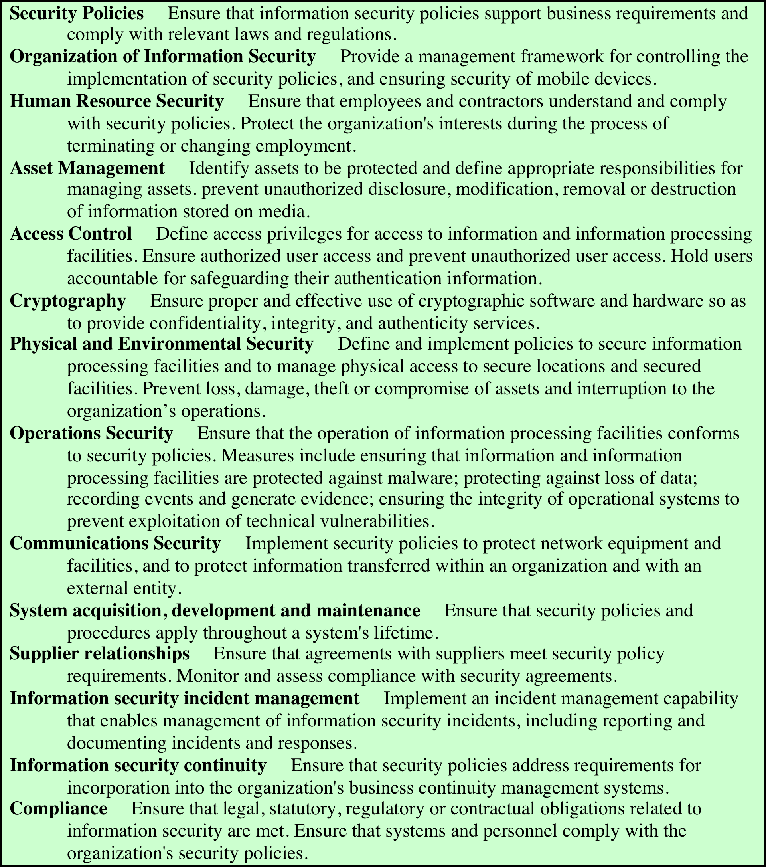
Detailed Security Controls
Notes:
Lists of controls are provided in a number of national and international
standards, including ISO 27002 (Code of practice for information security management,
2013), ISO 13335 (Management of information and communications technology
security, 2004), FIPS 200 (Minimum Security Requirements for Federal Information
and Information Systems, March 2006) and NIST SP 800-53 (Recommended Security
Controls for Federal Information Systems, January 2015). There is broad agreement
among these and other standards as to the types of controls that should be used and
the detailed lists of typical controls. Indeed many of the standards cross-reference each
other, indicating their agreement on these lists. ISO 27002 is generally regarded as the
master list of controls and is cited by most other standards. Table 15.1 (adapted from
Table 1 in NIST SP 800-53) is a typical list of families of controls within each of the
classes.

Slide 49
Detailed Security Controls (2)
Notes:
Lists of controls are provided in a number of national and international
standards, including ISO 27002 (Code of practice for information security management,
2013), ISO 13335 (Management of information and communications technology
security, 2004), FIPS 200 (Minimum Security Requirements for Federal Information
and Information Systems, March 2006) and NIST SP 800-53 (Recommended Security
Controls for Federal Information Systems, January 2015). There is broad agreement
among these and other standards as to the types of controls that should be used and
the detailed lists of typical controls. Indeed many of the standards cross-reference each
other, indicating their agreement on these lists. ISO 27002 is generally regarded as the
master list of controls and is cited by most other standards. Table 15.1 (adapted from
Table 1 in NIST SP 800-53) is a typical list of families of controls within each of the
classes.

Slide 50
Detailed Security Controls (3)
Notes:
Lists of controls are provided in a number of national and international
standards, including ISO 27002 (Code of practice for information security management,
2013), ISO 13335 (Management of information and communications technology
security, 2004), FIPS 200 (Minimum Security Requirements for Federal Information
and Information Systems, March 2006) and NIST SP 800-53 (Recommended Security
Controls for Federal Information Systems, January 2015). There is broad agreement
among these and other standards as to the types of controls that should be used and
the detailed lists of typical controls. Indeed many of the standards cross-reference each
other, indicating their agreement on these lists. ISO 27002 is generally regarded as the
master list of controls and is cited by most other standards. Table 15.1 (adapted from
Table 1 in NIST SP 800-53) is a typical list of families of controls within each of the
classes.

Slide 51
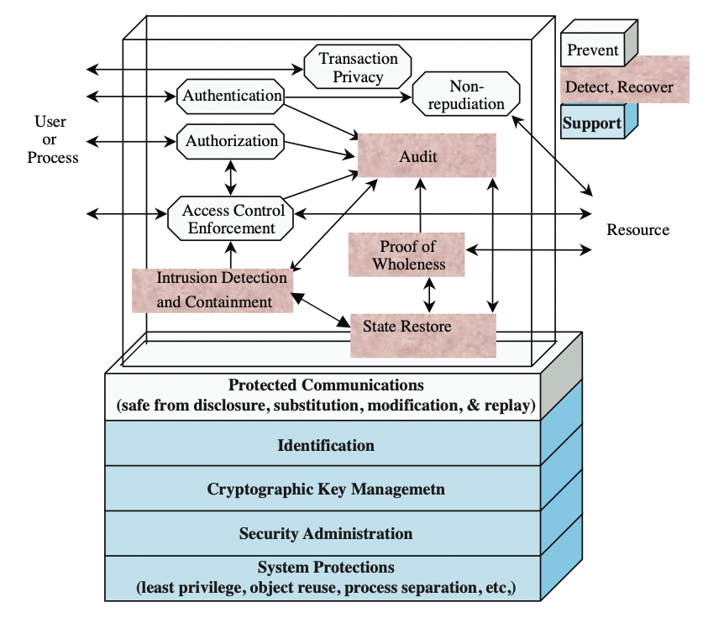
Technical Security Controls
Notes:
Some controls address multiple risks at the same time, and selecting such controls can
be very cost effective. Controls can be classified as belonging to one of the following
classes (although some controls include features from several of these):
• Management controls: Focus on security policies, planning, guidelines, and
standards that influence the selection of operational and technical controls to
reduce the risk of loss and to protect the organization’s mission. These controls
refer to issues that management needs to address. We discuss a number of these
in Chapters 14 and 15.
• Operational controls: Address the correct implementation and use of security
policies and standards, ensuring consistency in security operations and correcting
identified operational deficiencies. These controls relate to mechanisms
and procedures that are primarily implemented by people rather than systems.
They are used to improve the security of a system or group of systems. We will
discuss some of these in Chapters 16 and 17.
• Technical controls: Involve the correct use of hardware and software security
capabilities in systems. These range from simple to complex measures that work
together to secure critical and sensitive data, information, and IT systems functions.

Slide 52
IT Security Plan
Should include
Risks, recommended controls, action priority
Selected controls, resources needed
Responsible personnel, implementation dates
Maintenance requirements
Provides details of:
What will be done
What resources are needed
Who is responsible
Goal is to detail the actions needed to improve the identified deficiencies in the risk profile
Notes:
Having identified a range of possible controls from which management has selected
some to implement, an IT security plan should then be created, as indicated in
Figures 14.1 and 15.1 . This is a document that provides details as to what will be
done, what resources are needed, and who will be responsible. The goal is to detail
the actions needed to improve the identified deficiencies in the organization’s risk
profile in a timely manner. NIST SP 800-30 (Risk Management Guide for Information Technology
Systems, September 2012) suggests that this plan should include details of:
• Risks (asset/threat/vulnerability combinations)
• Recommended controls (from the risk assessment)
• Action priority for each risk
• Selected controls (on the basis of the cost-benefit analysis)
• Required resources for implementing the selected controls
• Responsible personnel
• Target start and end dates for implementation
• Maintenance requirements and other comments

Slide 53
Security Plan Implementation
Notes:
These details are summarized in an implementation plan table, such as
that shown in Table 15.4 . This illustrates an example implementation plan for
the example risk identified and shown in Table 14.5 . The suggested controls are
specific examples of remote access, auditable event, user identification, system
backup, and configuration change controls, applied to the identified threatened
asset. All of them are chosen, because they are neither costly nor difficult to
implement. They do require some changes to procedures. The relevant network
administration staff must be notified of these changes. Staff members may also
require training on the correct implementation of the new procedures and their
rights and responsibilities.

Slide 54
Security Plan Implementation (2)
IT security plan documents:
What needs to be done for each selected control
Personnel responsible
Resources and time frame
Identified personnel:
Implement new or enhanced controls
May need system configuration changes, upgrades or new system installation
May also involve development of new or extended procedures
Need to be encouraged and monitored by management
When implementation is completed management authorizes the system for operational use
Notes:
The next phase in the IT security management process, as indicated in Figure 14.1, is
to manage the implementation of the controls detailed in the IT security plan. This
comprises the do stage of the cyclic implementation model discussed in Chapter 14 .
The implementation phase comprises not only the direct implementation of the
controls as detailed in the security plan, but also the associated specific training and
general security awareness programs for the organization.
The IT security plan documents what needs to be done for each selected control,
along with the personnel responsible, and the resources and time frame to
be used. The identified personnel then undertake the tasks needed to implement
the new or enhanced controls, be they technical, managerial, or operational.
This may involve some combination of system configuration changes, upgrades,
or new system installation. It may also involve the development of new or
extended procedures to document practices needed to achieve the desired
security goals. Note that even technical controls typically require associated
operational procedures to ensure their correct use. The use of these procedures
needs to be encouraged and monitored by management.
The implementation process should be monitored to ensure its correctness.
This is typically performed by the organizational security officer, who checks that:
• The implementation costs and resources used stay within identified bounds.
• The controls are correctly implemented as specified in the plan, in order that
the identified reduction in risk level is achieved.
• The controls are operated and administered as needed.
When the implementation is successfully completed, management needs to
authorize the system for operational use. This may be a purely informal process
within the organization. Alternatively, especially in government organizations,
this may be part of a formal process resulting in accreditation of the system
as meeting required standards. This is usually associated with the installation,
certification, and use of trusted computing system, as we will discuss in Chapter 27 .
In these cases an external accrediting body will verify the documented evidence of
the correct design and implementation of the system.

Slide 55
Security Plan Implementation Follow-up
Security management is a cyclic process
Constantly repeated to respond to changes in the IT systems and the risk environment
Need to monitor implemented controls
Evaluate changes for security implications
Otherwise increase chance of security breach
Includes a number of aspects
Maintenance of security controls
Security compliance checking
Change and configuration management
Incident handling
Notes:
The IT security management process does not end with the implementation of
controls and the training of personnel. As we noted in Chapter 14, it is a cyclic
process, constantly repeated to respond to changes in the IT systems and the risk
environment. The various controls implemented should be monitored to ensure
their continued effectiveness. Any proposed changes to systems should be checked
for security implications and the risk profile of the affected system reviewed if
necessary. Unfortunately, this aspect of IT security management often receives
the least attention and in many cases is added as an afterthought, if at all. Failure
to do so can greatly increase the likelihood that a security failure will occur.
This follow-up stage of the management process includes a number of aspects:
• Maintenance of security controls
• Security compliance checking
• Change and configuration management
• Incident handling
Any of these aspects might indicate that changes are needed to the previous stages in
the IT security management process. An obvious example is that if a breach should
occur, such as a virus infection of desktop systems, then changes may be needed to
the risk assessment, to the controls chosen, or to the details of their implementation.
This can trigger a review of earlier stages in the process.

Slide 56
Security Plan Maintenance
Need continued maintenance and monitoring of implemented controls to ensure continued correct functioning and appropriateness
Goal is to ensure controls perform as intended
Periodic review of controls
Upgrade of controls to meet new requirements
System changes do not impact controls
Address new threats or vulnerabilities
Notes:
The first aspect concerns the continued maintenance and monitoring of the
implemented controls to ensure their continued correct functioning and
appropriateness. It is important that someone has responsibility for this maintenance
process, which is generally coordinated by the organization’s security officer.
The maintenance tasks include ensuring that:
• Controls are periodically reviewed to verify that they still function as intended.
• Controls are upgraded when new requirements are discovered.
• Changes to systems do not adversely affect the controls.
• New threats or vulnerabilities have not become known.
This review includes regular analysis of log files to ensure various system
components are functioning as expected, and to determine a baseline of activity
against which abnormal events can be compared when handling incidents.
We discuss security auditing further in Chapter 18 .
The goal of maintenance is to ensure that the controls continue to perform as
intended, and hence that the organization’s risk exposure remains as chosen. Failure
to maintain controls could lead to a security breach with a potentially significant
impact on the organization.

Slide 57
Network Scanning and Vulnerability Scanning
Digital Forensics
Cybersecurity Engineering
Security policies
Firewalls
Authentication, Access controls
Federated trust
IoT/Cloud middleware
Module 4 – Defense Architectures and Design

Slide 58
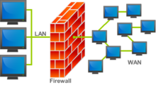
The Need For Firewalls
Internet connectivity is essential
However it creates a threat
Effective means of protecting LANs
Inserted between the premises network and the Internet to establish a controlled link
Can be a single computer system or a set of two or more systems working together
Used as a perimeter defense
Single choke point to impose security and auditing
Insulates the internal systems from external networks
Notes:
Internet connectivity is no longer optional for organizations. The information
and services available are essential to the organization. Moreover, individual users
within the organization want and need Internet access, and if this is not provided
via their LAN, they could use a wireless broadband capability from their PC to an
Internet service provider (ISP). However, while Internet access provides benefits to
the organization, it enables the outside world to reach and interact with local network
assets. This creates a threat to the organization. While it is possible to equip
each workstation and server on the premises network with strong security features,
such as intrusion protection, this may not be sufficient and in some cases is not cost effective.
Consider a network with hundreds or even thousands of systems, running
various operating systems, such as different versions of Windows, MacOS, and
Linux. When a security flaw is discovered, each potentially affected system must be
upgraded to fix that flaw. This requires scaleable configuration management and
aggressive patching to function effectively. While difficult, this is possible and is necessary
if only host-based security is used. A widely accepted alternative or at least
complement to host-based security services is the firewall. The firewall is inserted
between the premises network and the Internet to establish a controlled link and to
erect an outer security wall or perimeter. The aim of this perimeter is to protect the
premises network from Internet-based attacks and to provide a single choke point
where security and auditing can be imposed. The firewall may be a single computer
system or a set of two or more systems that cooperate to perform the firewall function.
The firewall, then, provides an additional layer of defense, insulating the internal
systems from external networks. This follows the classic military doctrine of
“defense in depth,” which is just as applicable to IT security.

Slide 59
Firewall Characteristics
Design Goals:
All traffic from inside to outside, and vice versa, must pass through the firewall
Only authorized traffic as defined by the local security policy will be allowed to pass
The firewall itself is immune to penetration
Not always true
The firewall of a large-sized enterprise network can typically have a ruleset or ACL (Access Control List) comprising 10K+ rules
Last-matching rules are located at the bottom of the ruleset and consume the most CPU processing power of firewalls
If these rules get discovered by an attacker, the attacker can effectively launch a low-rate DoS attack that can bring the firewall to its knees
Countermeasures: Random delay, periodic re-arranging of rules or caching
K. Salah, K. Sattar, A. Baig, M. Squalli, P. Calyam, “Resiliency of Popular Network Firewalls against Remote Discovery of Last-Matching Rules”, ACM Conference on Security of Information and Networks (SIN), 2009.
Notes:
[BELL94] lists the following design goals for a firewall:
1. All traffic from inside to outside, and vice versa, must pass through the firewall.
This is achieved by physically blocking all access to the local network except via
the firewall. Various configurations are possible, as explained later in this chapter.
2. Only authorized traffic, as defined by the local security policy, will be allowed
to pass. Various types of firewalls are used, which implement various types of
security policies, as explained later in this chapter.
3. The firewall itself is immune to penetration. This implies the use of a hardened
system with a secured operating system, as we will describe in Chapter 12.

Slide 60
Firewall Access Policy
A critical component in the planning and implementation of a firewall is specifying a suitable access policy
This lists the types of traffic authorized to pass through the firewall
Includes address ranges, protocols, applications and content types
This policy should be developed from the organization’s information security risk assessment and policy
Should be developed from a broad specification of which traffic types the organization needs to support
Then refined to detail the filter elements which can then be implemented within an appropriate firewall topology
Notes:
A critical component in the planning and implementation of a firewall is
specifying a suitable access policy. This lists the types of traffic authorized to pass
through the firewall, including address ranges, protocols, applications and content
types. This policy should be developed from the organization’s information security
risk assessment and policy, that we discuss in Chapters 14 and 15. This policy
should be developed from a broad specification of which traffic types the organization
needs to support. It is then refined to detail the filter elements we discuss next,
which can then be implemented within an appropriate firewall topology.

Slide 61
Firewall Filter Characteristics
Characteristics that a firewall access policy could use to filter traffic include (as per NIST SP 800-41):
IP address and protocol values
This type of filtering is used by packet filter and stateful inspection firewalls
Typically used to limit access to specific services
Application protocol
This type of filtering is used by an application-level gateway that relays and monitors the exchange of information for specific application protocols
User identity
Typically for inside users who identify themselves using some form of secure authentication technology
Network activity
Controls access based on considerations such as the time or request, rate of requests, or other activity patterns
Notes:
NIST SP 800-41 (Guidelines on Firewalls and Firewall Policy, September 2009)
lists a range of characteristics that a firewall access policy could use to filter traffic,
including:
• IP Address and Protocol Values: Controls access based on the source or
destination addresses and port numbers, direction of flow being inbound or
outbound, and other network and transport layer characteristics. This type of
filtering is used by packet filter and stateful inspection firewalls. It is typically
used to limit access to specific services.
• Application Protocol: Controls access on the basis of authorized application
protocol data. This type of filtering is used by an application-level gateway
that relays and monitors the exchange of information for specific application
protocols, for example, checking Simple Mail Transfer Protocol (SMTP) e-mail for spam, or HTPP Web requests to
authorized sites only.
• User Identity: Controls access based on the users identity, typically for inside
users who identify themselves using some form of secure authentication technology,
such as IPSec (Chapter 22).
• Network Activity: Controls access based on considerations such as the time or
request, for example, only in business hours; rate of requests, for example, to detect scanning
attempts; or other activity patterns.

Slide 62
Firewall Capabilities and Limits
Capabilities:
Defines a single choke point
Provides a location for monitoring security events
Convenient platform for several Internet functions that are not security related
Can serve as the platform for IPSec
IPSec is a standard suite of protocols between 2 communication points across the IP network that provide data authentication, integrity, and confidentiality; It also defines the encrypted, decrypted and authenticated packets
Limitations:
Cannot protect against attacks bypassing firewall
May not protect fully against internal threats
Improperly secured wireless LAN can be accessed from outside the organization
Laptop, or portable storage device may be infected outside the corporate network then used internally
Notes:
Before proceeding to the details of firewall types and configurations, it is best
to summarize what one can expect from a firewall. The following capabilities are
within the scope of a firewall:
1. A firewall defines a single choke point that attempts to keep unauthorized
users out of the protected network, prohibit potentially vulnerable services
from entering or leaving the network, and provide protection from various
kinds of IP spoofing and routing attacks. The use of a single choke point
simplifies security management because security capabilities are consolidated
on a single system or set of systems.
2. A firewall provides a location for monitoring security-related events. Audits
and alarms can be implemented on the firewall system.
3. A firewall is a convenient platform for several Internet functions that are not
security related. These include a network address translator, which maps local
addresses to Internet addresses, and a network management function that
audits or logs Internet usage.
4. A firewall can serve as the platform for IPSec. Using the tunnel mode capability
described in Chapter 22 , the firewall can be used to implement virtual
private networks.
Firewalls have their limitations, including the following:
1. The firewall cannot protect against attacks that bypass the firewall. Internal
systems may have dial-out or mobile broadband capability to connect to
an ISP. An internal LAN may support a modem pool that provides dial-in
capability for traveling employees and telecommuters.
2. The firewall may not protect fully against internal threats, such as a disgruntled
employee or an employee who unwittingly cooperates with an external
attacker.
3. An improperly secured wireless LAN may be accessed from outside the
organization. An internal firewall that separates portions of an enterprise
network cannot guard against wireless communications between local systems
on different sides of the internal firewall.
4. A laptop, PDA, or portable storage device may be used and infected outside
the corporate network and then attached and used internally.

Slide 63
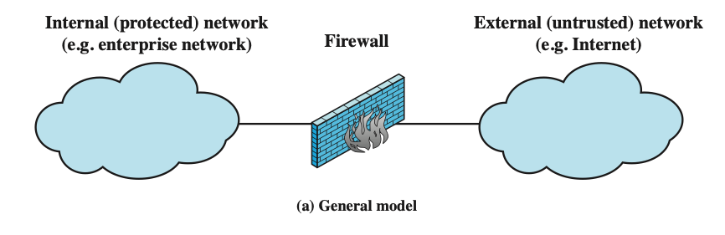
Types of Firewalls
Notes:
A firewall can monitor network traffic at a number of levels, from low-level network
packets, either individually or as part of a flow, to all traffic within a transport connection,
up to inspecting details of application protocols. The choice of which level
is appropriate is determined by the desired firewall access policy. It can operate as a
positive filter, allowing to pass only packets that meet specific criteria, or as a negative
filter, rejecting any packet that meets certain criteria. The criteria implement the
access policy for the firewall that we discussed in the previous section. Depending
on the type of firewall, it may examine one or more protocol headers in each packet,
the payload of each packet, or the pattern generated by a sequence of packets. In this
section, we look at the principal types of firewalls.

Slide 64
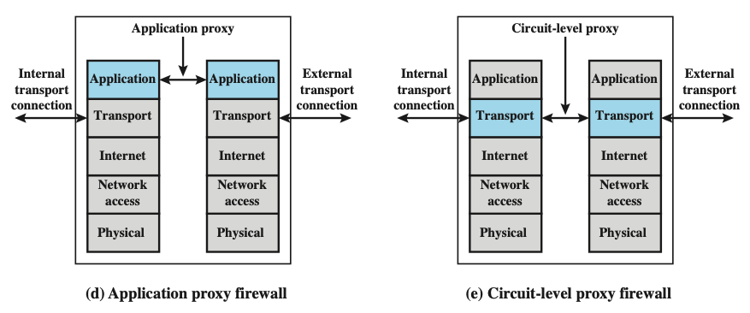
Types of Firewalls (2)
Notes:
A firewall can monitor network traffic at a number of levels, from low-level network
packets, either individually or as part of a flow, to all traffic within a transport connection,
up to inspecting details of application protocols. The choice of which level
is appropriate is determined by the desired firewall access policy. It can operate as a
positive filter, allowing to pass only packets that meet specific criteria, or as a negative
filter, rejecting any packet that meets certain criteria. The criteria implement the
access policy for the firewall that we discussed in the previous section. Depending
on the type of firewall, it may examine one or more protocol headers in each packet,
the payload of each packet, or the pattern generated by a sequence of packets. In this
section, we look at the principal types of firewalls.

Slide 65
Packet Filtering Firewall
Applies rules to each incoming and outgoing IP packet
Typically a list of rules based on matches in the IP or TCP header
Forwards or discards the packet based on rules match
Two default policies:
Discard - prohibit unless expressly permitted
More conservative, controlled, visible to users
Forward - permit unless expressly prohibited
Easier to manage and use but less secure
Filtering rules are based on information contained in a network packet
Source IP address
Destination IP address
Source and destination transport-level address
IP protocol field
Interface
Notes:
A packet filtering firewall applies a set of rules to each incoming and outgoing
IP packet and then forwards or discards the packet ( Figure 9.1b ). The firewall
is typically configured to filter packets going in both directions (from and to
the internal network). Filtering rules are based on information contained in a
network packet:
• Source IP address: The IP address of the system that originated the IP packet
(e.g., 192.178.1.1)
• Destination IP address: The IP address of the system the IP packet is trying to
reach (e.g., 192.168.1.2)
• Source and destination transport-level address: The transport-level (e.g., TCP
or UDP) port number, which defines applications such as SNMP or HTTP.
• IP protocol field: Defines the transport protocol
• Interface: For a firewall with three or more ports, which interface of the firewall
the packet came from or for which interface of the firewall the packet is destined.
The packet filter is typically set up as a list of rules based on matches to fields
in the IP or TCP header. If there is a match to one of the rules, that rule is invoked
to determine whether to forward or discard the packet. If there is no match to any
rule, then a default action is taken. Two default policies are possible:
• Default = discard: That which is not expressly permitted is prohibited.
• Default = forward: That which is not expressly prohibited is permitted.
The default discard policy is more conservative. Initially, everything is blocked,
and services must be added on a case-by-case basis. This policy is more visible to
users, who are more likely to see the firewall as a hindrance. However, this is the
policy likely to be preferred by businesses and government organizations. Further,
visibility to users diminishes as rules are created. The default forward policy increases
ease of use for end users but provides reduced security; the security administrator
must, in essence, react to each new security threat as it becomes known. This policy
may be used by generally more open organizations, such as universities.

Slide 66
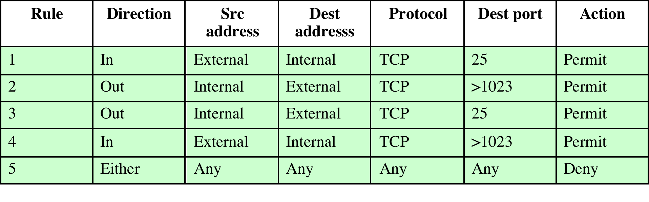
Packet Filtering Examples
Do you see problems with this rule set?
Rule 4 allows external traffic to any destination port above 1023. As an example of an exploit of this rule, an
external attacker can open a connection from the attacker’s port 5150 to an internal Web proxy server on port 8080. This is supposed to be forbidden and could allow an attack on the server.
To counter this attack, the firewall rule set can be configured with a source port field for each row. For rules 2 and 4, the source port is set to 25; for rules 1 and 3, the source port is set to >1023.
Notes:
Table 9.1 is a simplified example of a rule set for SMTP traffic. The goal is to
allow inbound and outbound email traffic but to block all other traffic. The rules are
applied top to bottom to each packet. The intent of each rule is:
1. Inbound mail from an external source is allowed (port 25 is for SMTP incoming).
2. This rule is intended to allow a response to an inbound SMTP connection.
3. Outbound mail to an external source is allowed.
4. This rule is intended to allow a response to an inbound SMTP connection.
5. This is an explicit statement of the default policy. All rule sets include this rule
implicitly as the last rule.
There are several problems with this rule set. Rule 4 allows external traffic
to any destination port above 1023. As an example of an exploit of this rule, an
external attacker can open a connection from the attacker’s port 5150 to an internal
Web proxy server on port 8080. This is supposed to be forbidden and could allow an
attack on the server. To counter this attack, the firewall rule set can be configured
with a source port field for each row. For rules 2 and 4, the source port is set to 25;
for rules 1 and 3, the source port is set to >1023.
But a vulnerability remains. Rules 3 and 4 are intended to specify that any
inside host can send mail to the outside. A TCP packet with a destination port of
25 is routed to the SMTP server on the destination machine. The problem with this
rule is that the use of port 25 for SMTP receipt is only a default; an outside machine
could be configured to have some other application linked to port 25. As the revised
rule 4 is written, an attacker could gain access to internal machines by sending packets
with a TCP source port number of 25. To counter this threat, we can add an
ACK flag field to each row. For rule 4, the field would indicate that the ACK flag
must be set on the incoming packet. Rule 4 would now look like this:
Rule 4
Direction In
Src address External
Src port 25
Dest address Internal
Protocol TCP
Dest port >1023
Flag ACK
Action. Permit
The rule takes advantage of a feature of TCP connections. Once a connection
is set up, the ACK flag of a TCP segment is set to acknowledge segments sent from
the other side. Thus, this rule allows incoming packets with a source port number of
25 that include the ACK flag in the TCP segment.

Slide 67
Packet Filtering Advantages and Weaknesses
Advantages:
Simplicity
Typically transparent to users and are very fast
Weaknesses:
Cannot prevent attacks that employ application specific vulnerabilities or functions
Limited logging functionality
Do not support advanced user authentication
Vulnerable to attacks on TCP/IP protocol bugs
Improper configuration can lead to breaches
Notes:
One advantage of a packet filtering firewall is its simplicity. Also, packet filters
typically are transparent to users and are very fast. NIST SP 800-41 lists the following
weaknesses of packet filter firewalls:
• Because packet filter firewalls do not examine upper-layer data, they cannot
prevent attacks that employ application-specific vulnerabilities or functions.
For example, a packet filter firewall cannot block specific application
commands; if a packet filter firewall allows a given application, all functions
available within that application will be permitted.
• Because of the limited information available to the firewall, the logging
functionality present in packet filter firewalls is limited. Packet filter logs
normally contain the same information used to make access control decisions
(source address, destination address, and traffic type).
• Most packet filter firewalls do not support advanced user authentication
schemes. Once again, this limitation is mostly due to the lack of upper-layer
functionality by the firewall.
• Packet filter firewalls are generally vulnerable to attacks and exploits that take
advantage of problems within the TCP/IP specification and protocol stack,
such as network layer address spoofing . Many packet filter firewalls cannot
detect a network packet in which the OSI Layer 3 addressing information has
been altered. Spoofing attacks are generally employed by intruders to bypass
the security controls implemented in a firewall platform.
• Finally, due to the small number of variables used in access control decisions,
packet filter firewalls are susceptible to security breaches caused by improper
configurations. In other words, it is easy to accidentally configure a packet
filter firewall to allow traffic types, sources, and destinations that should be
denied based on an organization’s information security policy.
Some of the attacks that can be made on packet filtering firewalls and the
appropriate countermeasures are the following:
• IP address spoofing : The intruder transmits packets from the outside with a
source IP address field containing an address of an internal host. The attacker
hopes that the use of a spoofed address will allow penetration of systems that
employ simple source address security, in which packets from specific trusted
internal hosts are accepted. The countermeasure is to discard packets with an
inside source address if the packet arrives on an external interface. In fact, this
countermeasure is often implemented at the router external to the firewall.
• Source routing attacks: The source station specifies the route that a packet
should take as it crosses the Internet, in the hopes that this will bypass security
measures that do not analyze the source routing information. A countermeasure
is to discard all packets that use this option.
• Tiny fragment attacks: The intruder uses the IP fragmentation option to create
extremely small fragments and force the TCP header information into
a separate packet fragment. This attack is designed to circumvent filtering
rules that depend on TCP header information. Typically, a packet filter
will make a filtering decision on the first fragment of a packet. All subsequent
fragments of that packet are filtered out solely on the basis that
they are part of the packet whose first fragment was rejected. The attacker
hopes that the filtering firewall examines only the first fragment and that
the remaining fragments are passed through. A tiny fragment attack can be
defeated by enforcing a rule that the first fragment of a packet must contain
a predefined minimum amount of the transport header. If the first fragment
is rejected, the filter can remember the packet and discard all subsequent
fragments.

Slide 68
Types of Firewalls
Notes:
A firewall can monitor network traffic at a number of levels, from low-level network
packets, either individually or as part of a flow, to all traffic within a transport connection,
up to inspecting details of application protocols. The choice of which level
is appropriate is determined by the desired firewall access policy. It can operate as a
positive filter, allowing to pass only packets that meet specific criteria, or as a negative
filter, rejecting any packet that meets certain criteria. The criteria implement the
access policy for the firewall that we discussed in the previous section. Depending
on the type of firewall, it may examine one or more protocol headers in each packet,
the payload of each packet, or the pattern generated by a sequence of packets. In this
section, we look at the principal types of firewalls.

Slide 69
Stateful Inspection Firewall
Tightens rules for TCP traffic by creating a directory of outbound TCP connections
There is an entry for each currently established connection
Packet filter allows incoming traffic to high numbered ports only for those packets that fit the profile of one of the entries in this directory
Reviews packet information but also records information about TCP connections
Keeps track of TCP sequence numbers to prevent attacks that depend on the sequence number
Inspects data for protocols, especially critical commands
Notes:
A traditional packet filter makes filtering decisions on an individual packet basis
and does not take into consideration any higher-layer context. To understand what
is meant by context and why a traditional packet filter is limited with regard to context,
a little background is needed. Most standardized applications that run on top
of TCP follow a client/server model. For example, for the Simple Mail Transfer
Protocol (SMTP), e-mail is transmitted from a client system to a server system.
The client system generates new e-mail messages, typically from user input. The
server system accepts incoming e-mail messages and places them in the appropriate
user mailboxes. SMTP operates by setting up a TCP connection between client
and server, in which the TCP server port number, which identifies the SMTP server
application, is 25. The TCP port number for the SMTP client is a number between
1024 and 65535 that is generated by the SMTP client.
In general, when an application that uses TCP creates a session with a remote
host, it creates a TCP connection in which the TCP port number for the remote
(server) application is a number less than 1024 and the TCP port number for the
local (client) application is a number between 1024 and 65535. The numbers less
than 1024 are the “well-known” port numbers and are assigned permanently to
particular applications (e.g., 25 for server SMTP). The numbers between 1024 and
65535 are generated dynamically and have temporary significance only for the
lifetime of a TCP connection.
A simple packet filtering firewall must permit inbound network traffic on all
these high-numbered ports for TCP-based traffic to occur. This creates a vulnerability
that can be exploited by unauthorized users.

Slide 70
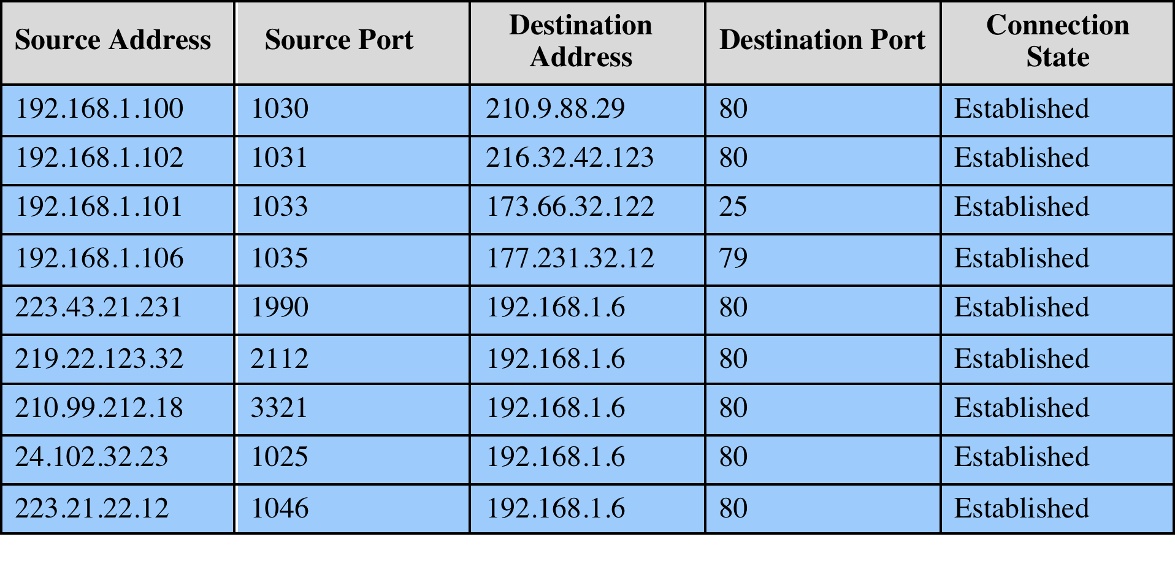
Example Stateful Firewall Connection State
Notes:
A stateful inspection packet firewall tightens up the rules for TCP traffic by
creating a directory of outbound TCP connections, as shown in Table 9.2 . There is
an entry for each currently established connection. The packet filter will now allow
incoming traffic to high-numbered ports only for those packets that fit the profile of
one of the entries in this directory.
A stateful packet inspection firewall reviews the same packet information
as a packet filtering firewall, but also records information about TCP connections
(Figure 9.1c). Some stateful firewalls also keep track of TCP sequence numbers
to prevent attacks that depend on the sequence number, such as session hijacking.
Some even inspect limited amounts of application data for some well-known
protocols like FTP, IM, and SIPS commands, in order to identify and track related
connections.

Slide 71
Types of Firewalls (2)
Notes:
A firewall can monitor network traffic at a number of levels, from low-level network
packets, either individually or as part of a flow, to all traffic within a transport connection,
up to inspecting details of application protocols. The choice of which level
is appropriate is determined by the desired firewall access policy. It can operate as a
positive filter, allowing to pass only packets that meet specific criteria, or as a negative
filter, rejecting any packet that meets certain criteria. The criteria implement the
access policy for the firewall that we discussed in the previous section. Depending
on the type of firewall, it may examine one or more protocol headers in each packet,
the payload of each packet, or the pattern generated by a sequence of packets. In this
section, we look at the principal types of firewalls.

Slide 72
Application-Level Gateway
Also called an application proxy
Acts as a relay of application-level traffic
User contacts gateway using a TCP/IP application
User is authenticated
Gateway contacts application on remote host and relays TCP segments between server and user
Must have proxy code for each application
May restrict application features supported
Tend to be more secure than packet filters
Disadvantage is the additional processing overhead on each connection
Notes:
An application-level gateway, also called an application proxy , acts as a relay of
application-level traffic ( Figure 9.1d ). The user contacts the gateway using a TCP/
IP application, such as Telnet or FTP, and the gateway asks the user for the name
of the remote host to be accessed. When the user responds and provides a valid
user ID and authentication information, the gateway contacts the application on
the remote host and relays TCP segments containing the application data between
the two endpoints. If the gateway does not implement the proxy code for a specific
application, the service is not supported and cannot be forwarded across the firewall.
Further, the gateway can be configured to support only specific features of an
application that the network administrator considers acceptable while denying all
other features.
Application-level gateways tend to be more secure than packet filters. Rather
than trying to deal with the numerous possible combinations that are to be allowed
and forbidden at the TCP and IP level, the application-level gateway need only
scrutinize a few allowable applications. In addition, it is easy to log and audit all
incoming traffic at the application level.
A prime disadvantage of this type of gateway is the additional processing
overhead on each connection. In effect, there are two spliced connections between
the end users, with the gateway at the splice point, and the gateway must examine
and forward all traffic in both directions.

Slide 73
Circuit-Level Gateway
Circuit-level proxy
Sets up two TCP connections, one between itself and a TCP user on an inner host and one on an outside host
Relays TCP segments from one connection to the other without examining contents
Security function consists of determining which connections will be allowed
Typically used when inside users are trusted
May use application-level gateway inbound and circuit-level gateway outbound
Lower overheads
Notes:
A fourth type of firewall is the circuit-level gateway or circuit-level proxy ( Figure 9.1e ).
This can be a stand-alone system or it can be a specialized function performed by an
application-level gateway for certain applications. As with an application gateway,
a circuit-level gateway does not permit an end-to-end TCP connection; rather,
the gateway sets up two TCP connections, one between itself and a TCP user on
an inner host and one between itself and a TCP user on an outside host. Once the
two connections are established, the gateway typically relays TCP segments from
one connection to the other without examining the contents. The security function
consists of determining which connections will be allowed.
A typical use of circuit-level gateways is a situation in which the system
administrator trusts the internal users. The gateway can be configured to support
application-level or proxy service on inbound connections and circuit-level functions
for outbound connections. In this configuration, the gateway can incur the processing
overhead of examining incoming application data for forbidden functions but
does not incur that overhead on outgoing data.

Slide 74
Network Scanning and Vulnerability Scanning
Digital Forensics
Cybersecurity Engineering
Security policies
Firewalls
Authentication, Access controls
Federated trust
IoT/Cloud middleware
Module 4 – Defense Architectures and Design

Slide 75
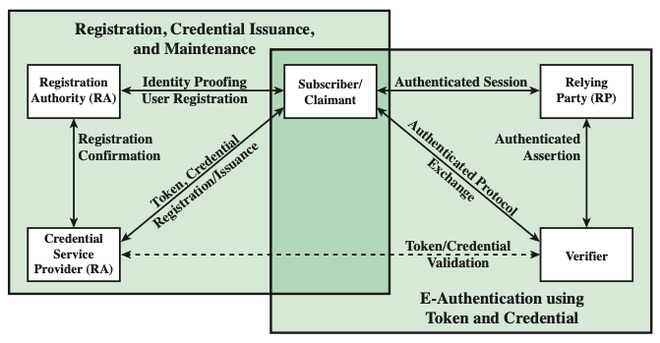
Authentication
The process of establishing confidence in user identities that are presented electronically to an information system
Notes:
NIST SP 800-63-3 (Digital Authentication Guideline , October 2016) defines digital
user authentication as the process of establishing confidence in user identities
that are presented electronically to an information system. Systems can use the
authenticated identity to determine if the authenticated individual is authorized
to perform particular functions, such as database transactions or access to system
resources. In many cases, the authentication and transaction, or other authorized
function, take place across an open network such as the Internet. Equally authentication
and subsequent authorization can take place locally, such as across a local
area network.

Slide 76
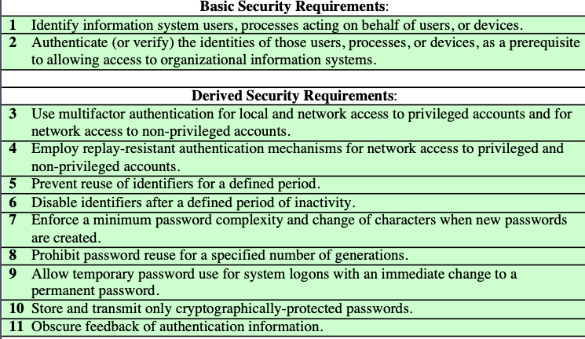
Identification and Authentication Security Requirements
Notes:
NIST SP 800-63-3 (Digital Authentication Guideline , October 2016) defines digital
user authentication as the process of establishing confidence in user identities
that are presented electronically to an information system. Systems can use the
authenticated identity to determine if the authenticated individual is authorized
to perform particular functions, such as database transactions or access to system
resources. In many cases, the authentication and transaction, or other authorized
function, take place across an open network such as the Internet. Equally authentication
and subsequent authorization can take place locally, such as across a local
area network.

Slide 77
Authenticating User Identity - Basis
Something the individual knows
Password, PIN, answers to prearranged questions
Something the individual possesses (token)
Smartphone, electronic keycard, physical key
Something the individual is (static biometrics)
Fingerprint, retina, face
Something the individual does (dynamic biometrics)
Voice pattern, handwriting, typing rhythm
Notes:
There are four general means of authenticating a user's identity, which can be used alone or in combination:
• Something the individual knows: Examples includes a password, a personal identification number (PIN), or answers to a prearranged set of questions.
• Something the individual possesses: Examples include electronic keycards, smart cards, and physical keys. This type of authenticator is referred to as a token.
• Something the individual is (static biometrics): Examples include recognition by fingerprint, retina, and face.
• Something the individual does (dynamic biometrics): Examples include recognition by voice pattern, handwriting characteristics, and typing rhythm.
All of these methods, properly implemented and used, can provide secure user authentication. However, each method has problems. An adversary may be able to guess or steal a password. Similarly, an adversary may be able to forge or steal a token. A user may forget a password or lose a token. Further, there is a significant administrative overhead for managing password and token information on systems and securing such information on systems. With respect to biometric authenticators, there are a variety of problems, including dealing with false positives and false negatives, user acceptance, cost, and convenience.

Slide 78
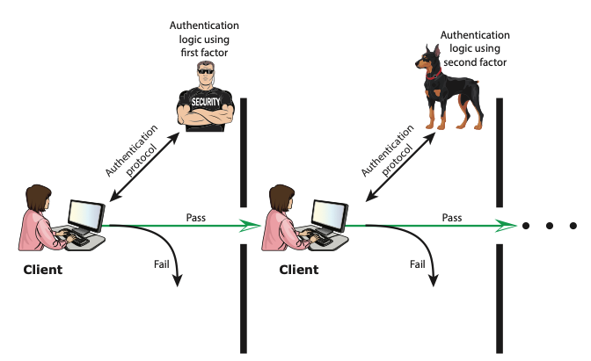
Multi-factor Authentication
Multifactor authentication refers to the use of more than one of the authentication means
Notes:
Multifactor authentication refers to the use
of more than one of the authentication means in the preceding list (see Figure 3.2).
The strength of authentication systems is largely determined by the number of factors
incorporated by the system. Implementations that use two factors are considered to
be stronger than those that use only one factor; systems that incorporate three factors
are stronger than systems that only incorporate two of the factors, and so on.

Slide 79
Risk Assessment for User Authentication
Assurance Level
Potential impact
Areas of risk

Slide 80
Assurance Level
Describes an organization’s degree of certainty that a user has presented a credential that refers to his or her identity
More specifically is defined as:
The degree of confidence in the vetting process used to establish the identity of the individual to whom the credential was issued
The degree of confidence that the individual who uses the credential is the individual to whom the credential was issued
Four levels of assurance
Level 1
Little or no confidence in the asserted identity's validity
Level 2
Some confidence in the asserted identity’s validity
Level 3
High confidence in the asserted identity's validity
Level 4
Very high confidence in the asserted identity’s validity
Notes:
An assurance level describes an organization’s degree of
certainty that a user has presented a credential that refers to his or her identity.
More specifically, assurance is defined as (1) the degree of confidence in the vetting
process used to establish the identity of the individual to whom the credential was
issued and (2) the degree of confidence that the individual who uses the credential is
the individual to whom the credential was issued. SP 800-63-3 recognizes four levels
of assurance:
• Level 1: Little or no confidence in the asserted identity’s validity. An example
of where this level is appropriate is a consumer registering to participate in
a discussion at a company web site discussion board. Typical authentication
technique at this level would be a user-supplied ID and password at the time
of the transaction.
• Level 2: Some confidence in the asserted identity’s validity. Level 2 credentials
are appropriate for a wide range of business with the public where organizations
require an initial identity assertion (the details of which are verified
independently prior to any action). At this level, some sort of secure authentication
protocol needs to be used, together with one of the means of authentication
summarized previously and discussed in subsequent sections.
• Level 3: High confidence in the asserted identity’s validity. This level is appropriate
to enable clients or employees to access restricted services of high value
but not the highest value. An example for which this level is appropriate:
A patent attorney electronically submits confidential patent information to
the U.S. Patent and Trademark Office. Improper disclosure would give competitors
a competitive advantage. Techniques that would need to be used at
this level require more than one factor of authentication; that is, at least two
independent authentication techniques must be used.
• Level 4: Very high confidence in the asserted identity’s validity. This level is
appropriate to enable clients or employees to access restricted services of very
high value or for which improper access is very harmful. For example, a law
enforcement official accesses a law enforcement database containing criminal
records. Unauthorized access could raise privacy issues and/or compromise
investigations. Typically, level 4 authentication requires the use of multiple
factors as well as in-person registration.

Slide 81
Potential Impact
FIPS 199 defines three levels of potential impact on organizations or individuals should there be a breach of security:
Low
An authentication error could be expected to have a limited adverse effect on organizational operations, organizational assets, or individuals
Moderate
An authentication error could be expected to have a serious adverse effect
High
An authentication error could be expected to have a severe or catastrophic adverse effect
Notes:
A concept closely related to that of assurance level is potential
impact. FIPS 199 (Standards for Security Categorization of Federal Information and
Information Systems, 2004) defines three levels of potential impact on organizations
or individuals should there be a breach of security (in our context, a failure in user
authentication):
• Low: An authentication error could be expected to have a limited adverse
effect on organizational operations, organizational assets, or individuals. More
specifically, we can say that the error might: (1) cause a degradation in mission
capability to an extent and duration that the organization is able to perform its
primary functions, but the effectiveness of the functions is noticeably reduced;
(2) result in minor damage to organizational assets; (3) result in minor financial
loss to the organization or individuals; or (4) result in minor harm to individuals.
• Moderate: An authentication error could be expected to have a serious
adverse effect. More specifically, the error might: (1) cause a significant degradation
in mission capability to an extent and duration that the organization is
able to perform its primary functions, but the effectiveness of the functions is
significantly reduced; (2) result in significant damage to organizational assets;
(3) result in significant financial loss; or (4) result in significant harm to individuals
that does not involve loss of life or serious life threatening injuries.
• High: An authentication error could be expected to have a severe or catastrophic
adverse effect. The error might: (1) cause a severe degradation in or
loss of mission capability to an extent and duration that the organization is not
able to perform one or more of its primary functions; (2) result in major damage
to organizational assets; (3) result in major financial loss to the organization
or individuals; or (4) result in severe or catastrophic harm to individuals
involving loss of life or serious life threatening injuries.

Slide 82
Maximum Potential Impacts for Each Assurance Level
Notes:
The mapping between the potential impact and the appropriate
level of assurance that is satisfactory to deal with the potential impact depends on the
context. Table 3.2 shows a possible mapping for various risks that an organization
may be exposed to. This table suggests a technique for doing risk assessment. For
a given information system or service asset of an organization, the organization
needs to determine the level of impact if an authentication failure occurs, using the
categories of impact, or risk areas, that are of concern.
For example, consider the potential for financial loss if there is an authentication
error that results in unauthorized access to a database. Depending on the
nature of the database, the impact could be:
• Low: At worst, an insignificant or inconsequential unrecoverable financial
loss to any party, or at worst, an insignificant or inconsequential organization
liability.
• Moderate: At worst, a serious unrecoverable financial loss to any party, or a
serious organization liability.
• High: severe or catastrophic unrecoverable financial loss to any party; or severe
or catastrophic organization liability.
The table indicates that if the potential impact is low, an assurance level of 1
is adequate. If the potential impact is moderate, an assurance level of 2 or 3 should
be achieved. And if the potential impact is high, an assurance level of 4 should be
implemented. Similar analysis can be performed for the other categories shown in
the table. The analyst can then pick an assurance level such that it meets or exceeds
the requirements for assurance in each of the categories listed in the table. So, for
example, for a given system, if any of the impact categories has a potential impact of
high, or if the personal safety category has a potential impact of moderate or high,
then level 4 assurance should be implemented.

Slide 83
Password Cracking
Dictionary attacks
Develop a large dictionary of possible passwords and try each against the password file
Each password must be hashed using each salt value and then compared to stored hash values
Rainbow table attacks
Pre-compute tables of hash values for all salts
A mammoth table of hash values
Can be countered by using a sufficiently large salt value and a sufficiently large hash length
Password crackers exploit the fact that people choose easily guessable passwords
Shorter password lengths are also easier to crack
John the Ripper
Open-source password cracker first developed in in 1996
Uses a combination of brute-force and dictionary techniques
Notes:
The traditional approach to password guessing,
or password cracking as it is called, is to develop a large dictionary of possible
passwords and to try each of these against the password file. This means that
each password must be hashed using each salt value in the password file and then
compared to stored hash values. If no match is found, then the cracking program
tries variations on all the words in its dictionary of likely passwords. Such variations
include backward spelling of words, additional numbers or special characters, or
sequence of characters,
An alternative is to trade off space for time by precomputing potential hash
values. In this approach the attacker generates a large dictionary of possible passwords.
For each password, the attacker generates the hash values associated with
each possible salt value. The result is a mammoth table of hash values known as a
rainbow table. For example, [OECH03] showed that using 1.4 GB of data, he could
crack 99.9% of all alphanumeric Windows password hashes in 13.8 seconds. This
approach can be countered by using a sufficiently large salt value and a sufficiently
large hash length. Both the FreeBSD and OpenBSD approaches should be secure
from this attack for the foreseeable future.
To counter the use of large salt values and hash lengths, password crackers
exploit the fact that some people choose easily guessable passwords. A particular
problem is that users, when permitted to choose their own password, tend to choose
short ones. [BONN12] summarizes the results of a number of studies over the past
few years involving over 40 million hacked passwords, as well as their own analysis
of almost 70 million anonymized passwords of Yahoo! users, and found a tendency
toward six to eight characters of length and a strong dislike of non-alphanumeric
characters in passwords.
The analysis of the 70 million passwords in [BONN12] estimates that passwords
provide fewer than 10 bits of security against an online, trawling attack,
and only about 20 bits of security against an optimal offline dictionary attack. In
other words, an attacker who can manage 10 guesses per account, typically within
the realm of rate-limiting mechanisms, will compromise around 1% of accounts,
just as they would against random 10-bit strings. Against an optimal attacker
performing unrestricted brute force and wanting to break half of all available
accounts, passwords appear to be roughly equivalent to 20-bit random strings.
It can be seen then that using offline search enables an adversary to break
a large number of accounts, even if a significant amount of iterated hashing is
Used.
Password length is only part of the problem. Many people, when permitted
to choose their own password, pick a password that is guessable, such as their
own name, their street name, a common dictionary word, and so forth. This makes
the job of password cracking straightforward. The cracker simply has to test the
password file against lists of likely passwords. Because many people use guessable
passwords, such a strategy should succeed on virtually all systems.
Attacks that use a combination of brute-force and dictionary techniques have
become common. A notable example of this dual approach is John the Ripper, an
open-source password cracker first developed in 1996 and still in use [OPEN13].

Slide 84
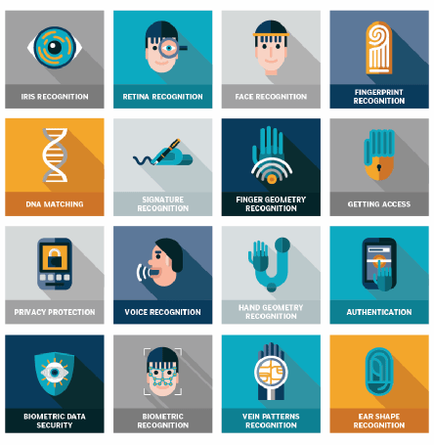
Biometric Authentication
Attempts to authenticate an individual based on unique physical characteristics
Based on pattern recognition
Is technically complex and expensive when compared to passwords and tokens
Physical characteristics used include:
Facial characteristics
Fingerprints
Hand geometry
Retinal pattern
Iris
Signature
Voice
Notes:
A biometric authentication system attempts to authenticate an individual based on
his or her unique physical characteristics. These include static characteristics, such
as fingerprints, hand geometry, facial characteristics, and retinal and iris patterns;
and dynamic characteristics, such as voiceprint and signature. In essence, biometrics
is based on pattern recognition. Compared to passwords and tokens, biometric
authentication is both technically complex and expensive. While it is used in a
number of specific applications, biometrics has yet to mature as a standard tool for
user authentication to computer systems.
A number of different types of physical characteristics are either in use or under
study for user authentication. The most common are the following:
• Facial characteristics: Facial characteristics are the most common means
of human-to-human identification; thus it is natural to consider them for
identification by computer. The most common approach is to define characteristics
based on relative location and shape of key facial features, such as
eyes, eyebrows, nose, lips, and chin shape. An alternative approach is to use an
infrared camera to produce a face thermogram that correlates with the underlying
vascular system in the human face.
• Fingerprints: Fingerprints have been used as a means of identification for
centuries, and the process has been systematized and automated particularly
for law enforcement purposes. A fingerprint is the pattern of ridges and
furrows on the surface of the fingertip. Fingerprints are believed to be unique
across the entire human population. In practice, automated fingerprint recognition
and matching system extract a number of features from the fingerprint
for storage as a numerical surrogate for the full fingerprint pattern.
• Hand geometry: Hand geometry systems identify features of the hand,
including shape, and lengths and widths of fingers.
• Retinal pattern: The pattern formed by veins beneath the retinal surface is
unique and therefore suitable for identification. A retinal biometric system
obtains a digital image of the retinal pattern by projecting a low-intensity
beam of visual or infrared light into the eye.
• Iris: Another unique physical characteristic is the detailed structure of the iris.
• Signature: Each individual has a unique style of handwriting and this is
reflected especially in the signature, which is typically a frequently written
sequence. However, multiple signature samples from a single individual will
not be identical. This complicates the task of developing a computer representation
of the signature that can be matched to future samples.
• Voice: Whereas the signature style of an individual reflects not only the unique
physical attributes of the writer but also the writing habit that has developed,
voice patterns are more closely tied to the physical and anatomical characteristics
of the speaker. Nevertheless, there is still a variation from sample to sample over
time from the same speaker, complicating the biometric recognition task.

Slide 85
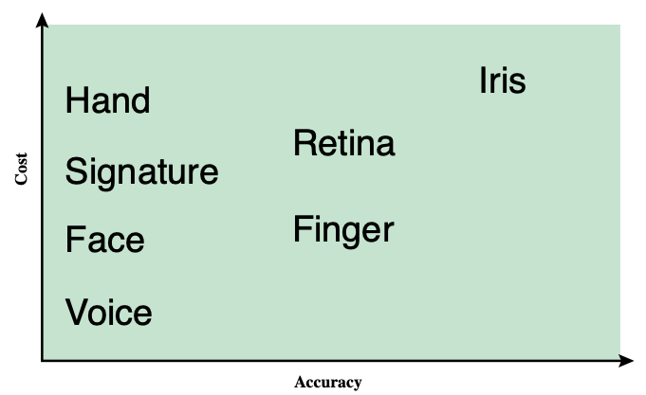
Biometric Authentication – Cost vs. Accuracy
Notes:
Figure 3.8 gives a rough indication of the relative cost and accuracy of these
biometric measures. The concept of accuracy does not apply to user authentication
schemes using smart cards or passwords. For example, if a user enters a password,
it either matches exactly the password expected for that user or not. In the case of
biometric parameters, the system instead must determine how closely a presented
biometric characteristic matches a stored characteristic. Before elaborating on the
concept of biometric accuracy, we need to have a general idea of how biometric
systems work.

Slide 86
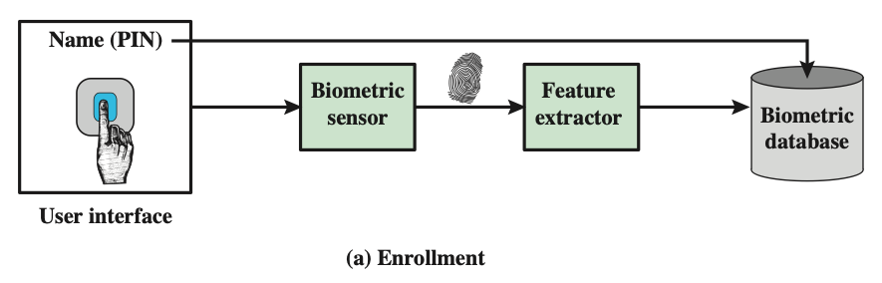
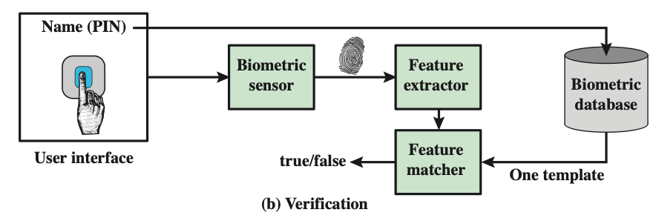
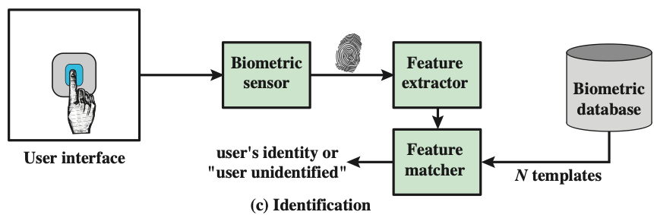
Biometric Authentication – Process
Notes:
Figure 3.9 illustrates the operation of a biometric system. Each individual who is to be
included in the database of authorized users must first be enrolled in the system. This
is analogous to assigning a password to a user. For a biometric system, the user presents
a name and, typically, some type of password or PIN to the system. At the same
time the system senses some biometric characteristic of this user (e.g., fingerprint of
right index finger). The system digitizes the input and then extracts a set of features
that can be stored as a number or set of numbers representing this unique biometric
characteristic; this set of numbers is referred to as the user’s template. The user is now
enrolled in the system, which maintains for the user a name (ID), perhaps a PIN or
password, and the biometric value.
Depending on application, user authentication on a biometric system involves
either verification or identification. Verification is analogous to a user logging on
to a system by using a memory card or smart card coupled with a password or PIN.
For biometric verification, the user enters a PIN and also uses a biometric sensor.
The system extracts the corresponding feature and compares that to the template
stored for this user. If there is a match, then the system authenticates this user.
For an identification system, the individual uses the biometric sensor but
presents no additional information. The system then compares the presented
template with the set of stored templates. If there is a match, then this user is
identified. Otherwise, the user is rejected.

Slide 87
Authentication Security Issues
Authentication Security Issues
Eavesdropping
Adversary attempts to learn the password by some sort of attack that involves the physical proximity of user and adversary
Host Attacks
Directed at the user file at the host where passwords, token passcodes, or biometric templates are stored
Replay
Adversary repeats a previously captured user response
Client Attacks
Adversary attempts to achieve user authentication without access to the remote host or the intervening communications path
Trojan Horse An application or physical device masquerades as an authentic application or device for the purpose of capturing a user password, passcode, or biometric
Denial-of-Service
Attempts to disable a user authentication service by flooding the service with numerous authentication attempts
Notes:
Client attacks are those in which an adversary attempts to achieve user
authentication without access to the remote host or to the intervening communications
path. The adversary attempts to masquerade as a legitimate user. For a password-
based system, the adversary may attempt to guess the likely user password.
Multiple guesses may be made. At the extreme, the adversary sequences through
all possible passwords in an exhaustive attempt to succeed. One way to thwart such
an attack is to select a password that is both lengthy and unpredictable. In effect,
such a password has large entropy; that is, many bits are required to represent the
password. Another countermeasure is to limit the number of attempts that can be
made in a given time period from a given source.
A token can generate a high-entropy passcode from a low-entropy PIN or password,
thwarting exhaustive searches. The adversary may be able to guess or acquire
the PIN or password but must additionally acquire the physical token to succeed.
Host attacks are directed at the user file at the host where passwords, token
passcodes, or biometric templates are stored. Section 3.2 discusses the security
considerations with respect to passwords. For tokens, there is the additional
defense of using one-time passcodes, so that passcodes are not stored in a host
passcode file. Biometric features of a user are difficult to secure because they are
physical features of the user. For a static feature, biometric device authentication
adds a measure of protection. For a dynamic feature, a challenge-response
protocol enhances security.
Eavesdropping in the context of passwords refers to an adversary’s attempt to
learn the password by observing the user, finding a written copy of the password,
or some similar attack that involves the physical proximity of user and adversary.
Another form of eavesdropping is keystroke logging (keylogging), in which malicious
hardware or software is installed so that the attacker can capture the user’s keystrokes
for later analysis. A system that relies on multiple factors (e.g., password plus token or
password plus biometric) is resistant to this type of attack. For a token, an analogous
threat is theft of the token or physical copying of the token. Again, a multifactor
protocol resists this type of attack better than a pure token protocol. The analogous
threat for a biometric protocol is copying or imitating the biometric
parameter so as to generate the desired template. Dynamic biometrics are less susceptible
to such attacks. For static biometrics, device authentication is a useful countermeasure.
Replay attacks involve an adversary repeating a previously captured
user response. The most common countermeasure to such attacks is the challenge-response
protocol.
In a Trojan horse attack, an application or physical device masquerades as
an authentic application or device for the purpose of capturing a user password,
passcode, or biometric. The adversary can then use the captured information to
masquerade as a legitimate user. A simple example of this is a rogue bank machine
used to capture user ID/password combinations.
A denial-of-service attack attempts to disable a user authentication service by
flooding the service with numerous authentication attempts. A more selective attack
denies service to a specific user by attempting logon until the threshold is reached
that causes lockout to this user because of too many logon attempts. A multifactor
authentication protocol that includes a token thwarts this attack, because the
adversary must first acquire the token.

Slide 88
Potential Attacks, Susceptible Authenticators, and Typical Defenses
en·tro·py: lack of order or predictability; gradual decline into disorder
Notes:
As with any security service, user authentication, particularly remote user authentication,
is subject to a variety of attacks. Table 3.5, from [OGOR03], summarizes
the principal attacks on user authentication, broken down by type of authenticator.
Much of the table is self-explanatory. In this section, we expand on some of the
table’s entries.

Slide 89
Potential Attacks, Susceptible Authenticators, and Typical Defenses
Notes:
As with any security service, user authentication, particularly remote user authentication,
is subject to a variety of attacks. Table 3.5, from [OGOR03], summarizes
the principal attacks on user authentication, broken down by type of authenticator.
Much of the table is self-explanatory. In this section, we expand on some of the
table’s entries.

Slide 90
Network Scanning and Vulnerability Scanning
Digital Forensics
Cybersecurity Engineering
Security policies
Firewalls
Authentication, Access controls
Federated trust
IoT/Cloud middleware
Module 4 – Defense Architectures and Design

Slide 91
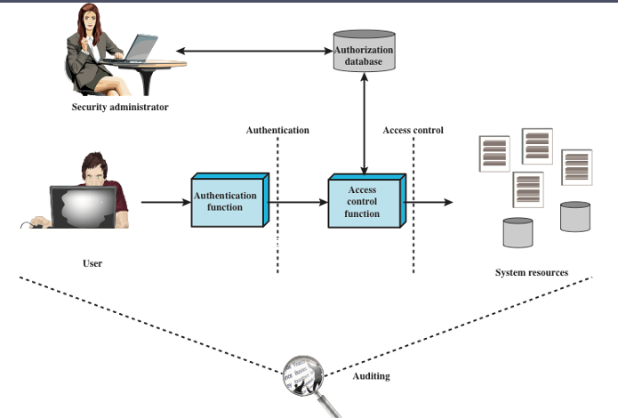
Access Control
Process by which use of system resources is regulated according to a security policy and is permitted only by authorized entities (users, programs, processes, or other systems) according to that policy
Notes:
NIST SP 800-63-3 (Digital Authentication Guideline , October 2016) defines digital
user authentication as the process of establishing confidence in user identities
that are presented electronically to an information system. Systems can use the
authenticated identity to determine if the authenticated individual is authorized
to perform particular functions, such as database transactions or access to system
resources. In many cases, the authentication and transaction, or other authorized
function, take place across an open network such as the Internet. Equally authentication
and subsequent authorization can take place locally, such as across a local
area network.

Slide 92
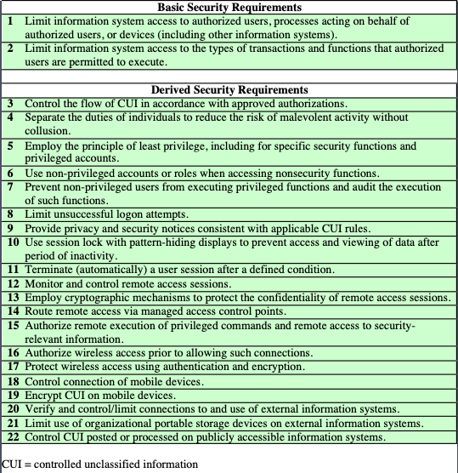
Access Control Security Requirements
Notes:
Table 4.1, from NIST SP 800-171 (Protecting Controlled Unclassified Information
in Nonfederal Information Systems and Organizations , August 2016), provides
a useful list of security requirements for access control services.

Slide 93
Access Control Policies
Discretionary access control (DAC)
Controls access based on the identity of the requestor and on access rules (authorizations) stating what requestors are (or are not) allowed to do
Mandatory access control (MAC)
Controls access based on comparing security labels with security clearances
An entity that has clearance to access a resource may not, just by its own volition, enable another entity to access that resource
Role-based access control (RBAC)
Controls access based on the roles that users have within the system and on rules stating what accesses are allowed to users in given roles
Attribute-based access control (ABAC)
Controls access based on attributes of the user, the resource to be accessed, and current environmental conditions
These four policies are not mutually exclusive; an access control mechanism can employ two or even all three of these policies to cover different classes of system resources
Notes:
An access control policy, which can be embodied in an authorization database,
dictates what types of access are permitted, under what circumstances, and by
whom. Access control policies are generally grouped into the following categories:
• Discretionary access control (DAC): Controls access based on the identity
of the requestor and on access rules (authorizations) stating what requestors
are (or are not) allowed to do. This policy is termed discretionary because an
entity might have access rights that permit the entity, by its own volition, to
enable another entity to access some resource.
• Mandatory access control (MAC): Controls access based on comparing
security labels (which indicate how sensitive or critical system resources are)
with security clearances (which indicate system entities are eligible to access
certain resources). This policy is termed mandatory because an entity that has
clearance to access a resource may not, just by its own volition, enable another
entity to access that resource.
• Role-based access control (RBAC): Controls access based on the roles that
users have within the system and on rules stating what accesses are allowed to
users in given roles.
• Attribute-based access control (ABAC): Controls access based on attributes
of the user, the resource to be accessed, and current environmental
conditions.
DAC is the traditional method of implementing access control, and is examined
in Sections 4.3 and 4.4. MAC is a concept that evolved out of requirements for
military information security and is best covered in the context of trusted systems,
which we deal with in Chapter 27. Both RBAC and ABAC have become increasingly
popular, and are examined in Sections 4.5 and 4.6, respectively.
These four policies are not mutually exclusive. An access control mechanism
can employ two or even all three of these policies to cover different classes of system
resources.

Slide 94
Subjects, Objects, and Access Rights
Subject
An entity capable of accessing objects
Three classes
Owner
Group
World
Object
A resource to which access is controlled
Entity used to contain and/or receive information
Access right
Describes the way in which a subject may access an object
Could include:
Read
Write
Execute
Delete
Create
Search
Notes:
The basic elements of access control are: subject, object, and access right.
A subject is an entity capable of accessing objects. Generally, the concept of
subject equates with that of process. Any user or application actually gains access to
an object by means of a process that represents that user or application. The process
takes on the attributes of the user, such as access rights.
A subject is typically held accountable for the actions they have initiated,
and an audit trail may be used to record the association of a subject with security relevant
actions performed on an object by the subject.
Basic access control systems typically define three classes of subject, with
different access rights for each class:
• Owner: This may be the creator of a resource, such as a file. For system resources,
ownership may belong to a system administrator. For project resources, a project
administrator or leader may be assigned ownership.
• Group: In addition to the privileges assigned to an owner, a named group of
users may also be granted access rights, such that membership in the group is
sufficient to exercise these access rights. In most schemes, a user may belong
to multiple groups.
• World: The least amount of access is granted to users who are able to access the
system but are not included in the categories owner and group for this resource.
An object is a resource to which access is controlled. In general, an object
is an entity used to contain and/or receive information. Examples include records,
blocks, pages, segments, files, portions of files, directories, directory trees, mailboxes,
messages, and programs. Some access control systems also encompass, bits,
bytes, words, processors, communication ports, clocks, and network nodes.
The number and types of objects to be protected by an access control system
depends on the environment in which access control operates and the desired tradeoff
between security on the one hand and complexity, processing burden, and ease
of use on the other hand.
An access right describes the way in which a subject may access an object.
Access rights could include the following:
• Read: User may view information in a system resource (e.g., a file, selected
records in a file, selected fields within a record, or some combination). Read
access includes the ability to copy or print.
• Write: User may add, modify, or delete data in system resource (e.g., files,
records, programs). Write access includes read access.
• Execute: User may execute specified programs.
• Delete: User may delete certain system resources, such as files or records.
• Create: User may create new files, records, or fields.
• Search: User may list the files in a directory or otherwise search the directory.

Slide 95
Discretionary Access Control (DAC)
Scheme in which an entity may be granted access rights that permit the entity, by its own violation, to enable another entity to access some resource
Often provided using an access matrix
One dimension consists of identified subjects that may attempt data access to the resources
The other dimension lists the objects that may be accessed
Each entry in the matrix indicates the access rights of a particular subject for a particular object
Notes:
As was previously stated, a discretionary access control scheme is one in which an
entity may be granted access rights that permit the entity, by its own volition, to
enable another entity to access some resource. A general approach to DAC, as
exercised by an operating system or a database management system, is that of an
access matrix. The access matrix concept was formulated by Lampson [LAMP69,
LAMP71], and subsequently refined by Graham and Denning [GRAH72, DENN71]
and by Harrison et al. [HARR76].
One dimension of the matrix consists of identified subjects that may attempt
data access to the resources. Typically, this list will consist of individual users or
user groups, although access could be controlled for terminals, network equipment,
hosts, or applications instead of or in addition to users. The other dimension lists
the objects that may be accessed. At the greatest level of detail, objects may be
individual data fields. More aggregate groupings, such as records, files, or even the
entire database, may also be objects in the matrix. Each entry in the matrix indicates
the access rights of a particular subject for a particular object.

Slide 96
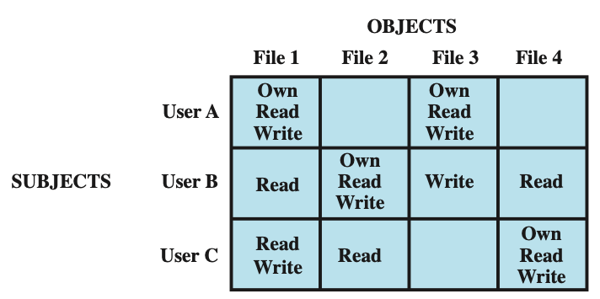
Access Control Structures Example
Access Matrix
User A owns files 1 and 3 and has read and write access rights to those
files. User B has read access rights to file 1, and so on.
Notes:
Figure 4.2a, based on a figure in [SAND94], is a simple example of an access
matrix. Thus, user A owns files 1 and 3 and has read and write access rights to those
files. User B has read access rights to file 1, and so on.

Slide 97
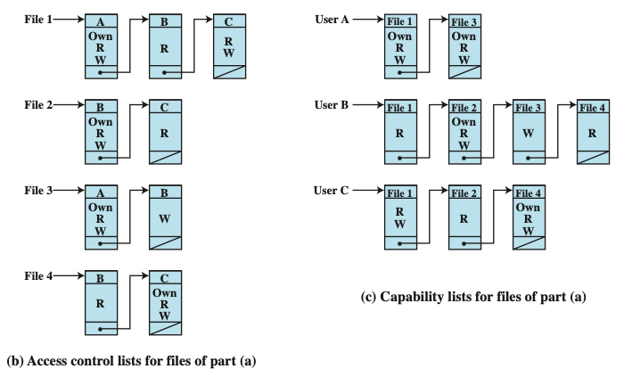
Access Control Lists
The access matrix may be decomposed by columns, yielding access control lists (ACLs)
For each object, an ACL lists users and their permitted access rights. The ACL may contain a default, or public, entry. This allows users that are not explicitly listed as having special rights to have a default set of rights. The default set of rights should always follow the rule of least privilege or read-only access, whichever is applicable. Elements of the list may include individual users as well as groups of users.
Notes:
In practice, an access matrix is usually sparse and is implemented by decomposition in one of two ways. The matrix may be decomposed by columns, yielding access control lists (ACLs); see Figure 4.2b. For each object, an ACL lists users and their permitted access rights. The ACL may contain a default, or public, entry. This allows users that are not explicitly listed as having special rights to have a default set of rights. The default set of rights should always follow the rule of least privilege or read-only access, whichever is applicable. Elements of the list may include individual users as well as groups of users.
When it is desired to determine which subjects have which access rights to a particular resource, ACLs are convenient, because each ACL provides the information for a given resource. However, this data structure is not convenient for determining the access rights available to a specific user.
Decomposition by rows yields capability tickets (Figure 4.2c). A capability
ticket specifies authorized objects and operations for a particular user. Each user
has a number of tickets and may be authorized to loan or give them to others.
Because tickets may be dispersed around the system, they present a greater
security problem than access control lists. The integrity of the ticket must be
protected, and guaranteed (usually by the operating system). In particular, the
ticket must be unforgeable. One way to accomplish this is to have the operating
system hold all tickets on behalf of users. These tickets would have to be held in
a region of memory inaccessible to users. Another alternative is to include an
unforgeable token in the capability. This could be a large random password, or a
cryptographic message authentication code. This value is verified by the relevant
resource whenever access is requested. This form of capability ticket is appropriate
for use in a distributed environment, when the security of its contents cannot
be guaranteed.
The convenient and inconvenient aspects of capability tickets are the opposite
of those for ACLs. It is easy to determine the set of access rights that a given user
has, but more difficult to determine the list of users with specific access rights for a
specific resource.

Slide 98
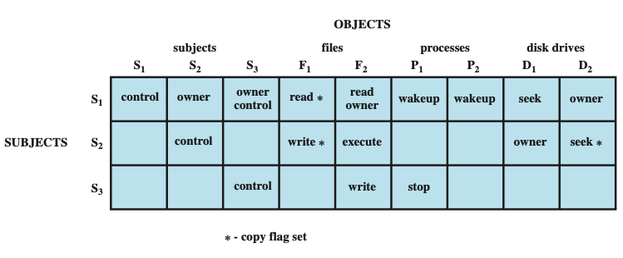
Extended Access Control Matrix
To represent the protection state, we extend the universe of objects in the access control matrix to include the following:
Processes: Access rights include the ability to delete a process, stop (block), and wake up a process
Devices: Access rights include the ability to read/write the device, to control its operation (e.g., a disk seek), and to block/unblock the device for use
Memory locations or regions: Access rights include the ability to read/write certain regions of memory that are protected such that the default is to disallow access
Subjects: Access rights with respect to a subject have to do with the ability to grantor delete access rights of that subject to other objects, as explained subsequently
Notes:
This section introduces a general model for DAC developed by Lampson, Graham,
and Denning [LAMP71, GRAH72, DENN71]. The model assumes a set of subjects,
a set of objects, and a set of rules that govern the access of subjects to objects. Let us
define the protection state of a system to be the set of information, at a given point in
time, that specifies the access rights for each subject with respect to each object. We can
identify three requirements: representing the protection state, enforcing access rights,
and allowing subjects to alter the protection state in certain ways. The model addresses
all three requirements, giving a general, logical description of a DAC system.
To represent the protection state, we extend the universe of objects in the
access control matrix to include the following:
• Processes: Access rights include the ability to delete a process, stop (block),
and wake up a process.
• Devices: Access rights include the ability to read/write the device, to control
its operation (e.g., a disk seek), and to block/unblock the device for use.
• Memory locations or regions: Access rights include the ability to read/write
certain regions of memory that are protected such that the default is to disallow
access.
• Subjects: Access rights with respect to a subject have to do with the ability to grant
or delete access rights of that subject to other objects, as explained subsequently.
Figure 4.3 is an example. For an access control matrix A, each entry A[S, X]
contains strings, called access attributes, that specify the access rights of subject S to
object X. For example, in Figure 4.3, S₁ may read file F₁, because ‘read’ appears in
A[S₁, F₁].
From a logical or functional point of view, a separate access control module is
associated with each type of object (Figure 4.4). The module evaluates each request
by a subject to access an object to determine if the access right exists. An access
attempt triggers the following steps:
1. A subject S₀ issues a request of type α for object X.
2. The request causes the system (the operating system or an access control interface
module of some sort) to generate a message of the form (S₀, α, X) to the
controller for X.
3. The controller interrogates the access matrix A to determine if α is in A[S₀, X].
If so, the access is allowed; if not, the access is denied and a protection violation
occurs. The violation should trigger a warning and appropriate action.

Slide 99
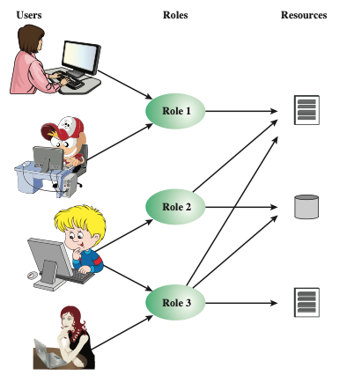
Role-Based Access Control
Traditional DAC systems define the access rights of individual users and groups of users
In contrast, RBAC is based on the roles that users assume in a system rather than the user’s identity
Typically, RBAC models define a role as a job function within an organization
RBAC systems assign access rights to roles instead of individual users
In turn, users are assigned to different roles, either statically or dynamically, according to their responsibilities
Users, Roles and Resources
Notes:
Traditional DAC systems define the access rights of individual users and groups
of users. In contrast, RBAC is based on the roles that users assume in a system
rather than the user’s identity. Typically, RBAC models define a role as a job function
within an organization. RBAC systems assign access rights to roles instead of
individual users. In turn, users are assigned to different roles, either statically or
dynamically, according to their responsibilities.
RBAC now enjoys widespread commercial use and remains an area of active
research. The National Institute of Standards and Technology (NIST) has issued a
standard, FIPS PUB 140-3, (Security Requirements for Cryptographic Modules September 2009),
that requires support for access control and administration through roles.
The relationship of users to roles is many to many, as is the relationship of
roles to resources, or system objects (Figure 4.6). The set of users changes, in some
environments frequently, and the assignment of a user to one or more roles may
also be dynamic. The set of roles in the system in most environments is relatively
static, with only occasional additions or deletions. Each role will have specific access
rights to one or more resources. The set of resources and the specific access rights
associated with a particular role are also likely to change infrequently.

Slide 100
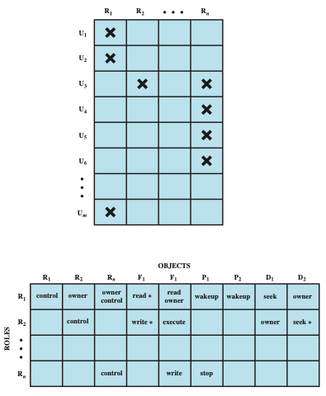
Access Control Matrix in RBAC
Notes:
We can use the access matrix representation to depict the key elements of an
RBAC system in simple terms, as shown in Figure 4.7. The upper matrix relates
individual users to roles. Typically there are many more users than roles. Each matrix
entry is either blank or marked, the latter indicating that this user is assigned to this
role. Note that a single user may be assigned multiple roles (more than one mark in a
row) and that multiple users may be assigned to a single role (more than one mark in
a column). The lower matrix has the same structure as the DAC access control matrix,
with roles as subjects. Typically, there are few roles and many objects, or resources.
In this matrix the entries are the specific access rights enjoyed by the roles. Note that a
role can be treated as an object, allowing the definition of role hierarchies.
RBAC lends itself to an effective implementation of the principle of least
privilege, referred to in Chapter 1. Each role should contain the minimum set of
access rights needed for that role. A user is assigned to a role that enables him or her
to perform only what is required for that role. Multiple users assigned to the same
role, enjoy the same minimal set of access rights.

Slide 101
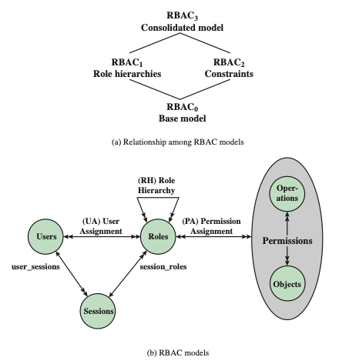
RBAC Models
Best Practice: Auth0
Notes:
A variety of functions and services can be included under the general RBAC
approach. To clarify the various aspects of RBAC, it is useful to define a set of
abstract models of RBAC functionality.
[SAND96] defines a family of reference models that has served as the basis
for ongoing standardization efforts. This family consists of four models that are
related to each other as shown in Figure 4.8a. and Table 4.4. RBAC₀ contains the
minimum functionality for an RBAC system. RBAC₁ includes the RBAC₀ functionality
and adds role hierarchies, which enable one role to inherit permissions
from another role. RBAC₂ includes RBAC₀ and adds constraints, which restrict
the ways in which the components of a RBAC system may be configured. RBAC₃
contains the functionality of RBAC₀, RBAC₁, and RBAC₂.
RBAC₀ Figure 4.8b, without the role hierarchy and constraints,
contains the four types of entities in an RBAC₀ system:
• User: An individual that has access to this computer system. Each individual
has an associated user ID.
Role: A named job function within the organization that controls this computer
system. Typically, associated with each role is a description of the authority and
responsibility conferred on this role, and on any user who assumes this role.
• Permission: An approval of a particular mode of access to one or more objects.
Equivalent terms are access right, privilege, and authorization.
• Session: A mapping between a user and an activated subset of the set of roles
to which the user is assigned.
The arrowed lines in Figure 4.8b indicate relationships, or mappings, with a
single arrowhead indicating one and a double arrowhead indicating many. Thus,
there is a many-to-many relationship between users and roles: One user may have
multiple roles, and multiple users may be assigned to a single role. Similarly, there
is a many-to-many relationship between roles and permissions. A session is used to
define a temporary one-to-many relationship between a user and one or more of the
roles to which the user has been assigned. The user establishes a session with only the
roles needed for a particular task; this is an example of the concept of least privilege.
The many-to-many relationships between users and roles and between roles
and permissions provide a flexibility and granularity of assignment not found in
conventional DAC schemes. Without this flexibility and granularity, there is a greater
risk that a user may be granted more access to resources than is needed because
of the limited control over the types of access that can be allowed. The NIST RBAC
document gives the following examples: Users may need to list directories and modify
existing files without creating new files, or they may need to append
records to a file without modifying existing records.

Slide 102
Attribute-Based Access Control
Can define authorizations that express conditions on properties of both the resource and the subject
Strength is its flexibility and expressive power
Main obstacle to its adoption in real systems has been concern about the performance impact of evaluating predicates on both resource and user properties for each access
Web services have been pioneering technologies through the introduction of the eXtensible Access Control Markup Language (XAMCL)
There is considerable interest in applying the model to cloud services
Notes:
A relatively recent development in access control technology is the attribute-based
access control (ABAC) model. An ABAC model can define authorizations that
express conditions on properties of both the resource and the subject. For example,
consider a configuration in which each resource has an attribute that identifies the
subject that created the resource. Then, a single access rule can specify the ownership
privilege for all the creators of every resource. The strength of the ABAC
approach is its flexibility and expressive power. [PLAT13] points out that the main
obstacle to its adoption in real systems has been concern about the performance
impact of evaluating predicates on both resource and user properties for each
access. However, for applications such as cooperating Web services and cloud computing,
this increased performance cost is less noticeable because there is already a
relatively high performance cost for each access. Thus, Web services have been pioneering
technologies for implementing ABAC models, especially through the introduction
of the eXtensible Access Control Markup Language (XAMCL) [BEUC13],
and there is considerable interest in applying the ABAC model to cloud services
[IQBA12, YANG12].
There are three key elements to an ABAC model: attributes, which are defined
for entities in a configuration; a policy model, which defines the ABAC policies; and
the architecture model, which applies to policies that enforce access control. We
examine these elements in turn.

Slide 103
ABAC Model Attributes
Subject attributes
A subject is an active entity that causes information to flow among objects or changes the system state
Object attributes
An object (or resource) is a passive information system-related entity containing or receiving information
Environment attributes
Describe the operational, technical, and even situational environment or context in which the information access occurs
Attributes define the identity and characteristics of the subject
Objects have attributes that can be leverages to make access control decisions
These attributes have so far been largely ignored in most access control policies
Notes:
Attributes are characteristics that define specific aspects of the subject, object, environment
conditions, and/or requested operations that are predefined and preassigned
by an authority. Attributes contain information that indicates the class of information
given by the attribute, a name, and a value (e.g., Class=HospitalRecordsAccess,
Name=PatientInformationAccess, Value=MFBusinessHoursOnly).
The following are the three types of attributes in the ABAC model:
• Subject attributes: A subject is an active entity (e.g., a user, an application, a
process, or a device) that causes information to flow among objects or changes
the system state. Each subject has associated attributes that define the identity
and characteristics of the subject. Such attributes may include the subject’s
identifier, name, organization, job title, and so on. A subject’s role can also be
viewed as an attribute.
• Object attributes: An object, also referred to as a resource , is a passive (in the
context of the given request) information system-related entity (e.g., devices,
files, records, tables, processes, programs, networks, domains) containing or
receiving information. As with subjects, objects have attributes that can be
leveraged to make access control decisions. A Microsoft Word document, for
example, may have attributes such as title, subject, date, and author. Object
attributes can often be extracted from the metadata of the object. In particular,
a variety of Web service metadata attributes may be relevant for access
control purposes, such as ownership, service taxonomy, or even Quality of
Service (QoS) attributes.
• Environment attributes: These attributes have so far been largely ignored in
most access control policies. They describe the operational, technical, and even
situational environment or context in which the information access occurs. For
example, attributes, such as current date and time, the current virus/hacker
activities, and the network’s security level (e.g., Internet vs. intranet), are not
associated with a particular subject nor a resource, but may nonetheless be
relevant in applying an access control policy.

Slide 104
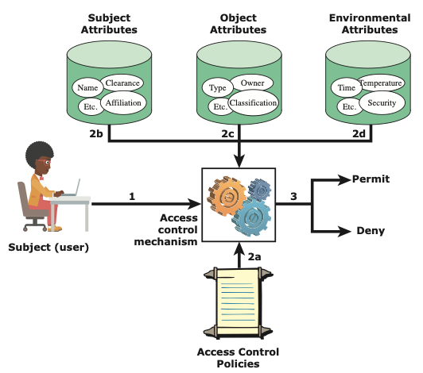
ABAC Scenario
It is clear from the logical architecture that there are four independent sources of information used for the access control decision. The system designer can decide which attributes are important for access control with respect to subjects, objects, and environmental conditions. The system designer or other authority can then define access control policies, in the form of rules, for any desired combination of attributes of subject, object, and environmental conditions.
Notes:
Figure 4.10 illustrates in a logical architecture the essential components of an ABAC
system. An access by a subject to an object proceeds according to the following steps:
1. A subject requests access to an object. This request is routed to an access control
mechanism.
2. The access control mechanism is governed by a set of rules (2a) that are defined
by a preconfigured access control policy. Based on these rules, the access control
mechanism assesses the attributes of the subject (2b), object (2c), and current
environmental conditions (2d) to determine authorization.
3. The access control mechanism grants the subject access to the object if access
is authorized and denies access if it is not authorized.
It is clear from the logical architecture that there are four independent sources
of information used for the access control decision. The system designer can decide
which attributes are important for access control with respect to subjects, objects,
and environmental conditions. The system designer or other authority can then
define access control policies, in the form of rules, for any desired combination of
attributes of subject, object, and environmental conditions. It should be evident that
this approach is very powerful and flexible. However, the cost, both in terms of
the complexity of the design and implementation and in terms of the performance
impact, is likely to exceed that of other access control approaches. This is a tradeoff
that the system authority must make.

Slide 105
ABAC Distinguishable Characteristics
Distinguishable because it controls access to objects by evaluating rules against the attributes of entities, operations, and the environment relevant to a request
Relies upon the evaluation of attributes of the subject, attributes of the object, and a formal relationship or access control rule defining the allowable operations for subject-object attribute combinations in a given environment
Systems are capable of enforcing DAC, RBAC, and MAC concepts
Allows an unlimited number of attributes to be combined to satisfy any access control rule
Apply ABAC if
You’re in a large organization with many users
You want deep, specific access control capabilities
You have time to invest in a model that goes the distance
You need to ensure privacy and security compliance
Notes:
ABAC is a logical access control model that is distinguishable because it controls
access to objects by evaluating rules against the attributes of entities (subject
and object), operations, and the environment relevant to a request. ABAC relies
upon the evaluation of attributes of the subject, attributes of the object, and a formal
relationship or access control rule defining the allowable operations for subject-object
attribute combinations in a given environment. All ABAC solutions contain
these basic core capabilities to evaluate attributes and enforce rules or relationships
between those attributes. ABAC systems are capable of enforcing DAC, RBAC,
and MAC concepts. ABAC enables fine-grained access control, which allows for a
higher number of discrete inputs into an access control decision, providing a bigger
set of possible combinations of those variables to reflect a larger and more definitive
set of possible rules, policies, or restrictions on access. Thus, ABAC allows an
unlimited number of attributes to be combined to satisfy any access control rule.
Moreover, ABAC systems can be implemented to satisfy a wide array of requirements
from basic access control lists through advanced expressive policy models
that fully leverage the flexibility of ABAC.

Slide 106
Enterprise-wide Access Control
Resource management
Concerned with defining rules for a resource that requires access control
Rules would include credential requirements and what user attributes, resource attributes, and environmental conditions are required for access of a given resource for a given function
Privilege management
Concerned with establishing and maintaining the entitlement or privilege attributes that comprise an individual’s access profile
These attributes represent features of an individual that can be used as the basis for determining access decisions to both physical and logical resources
Privileges are considered attributes that can be linked to a digital identity
Policy management
Governs what is allowable and unallowable in an access transaction
Notes:
Three support elements
are needed for an enterprise-wide access control facility:
• Resource management: This element is concerned with defining rules for
a resource that requires access control. The rules would include credential
requirements and what user attributes, resource attributes, and environmental
conditions are required for access of a given resource for a given
function.
• Privilege management: This element is concerned with establishing and maintaining
the entitlement or privilege attributes that comprise an individual’s
access profile. These attributes represent features of an individual that can be
used as the basis for determining access decisions to both physical and logical
resources. Privileges are considered attributes that can be linked to a digital
identity.
• Policy management: This element governs what is allowable and unallowable
in an access transaction. That is, given the identity and attributes of
the requestor, the attributes of the resource or object, and environmental
conditions, a policy specifies what actions this user can perform on this
object.

Slide 107
Network Scanning and Vulnerability Scanning
Digital Forensics
Cybersecurity Engineering
Security policies
Firewalls
Authentication, Access controls
Federated trust
IoT/Cloud middleware
Module 4 – Defense Architectures and Design

Slide 108
Identity Federation
Term used to describe the technology, standards, policies, and processes that allow an organization to trust digital identities, identity attributes, and credentials created and issued by another organization
Addresses two questions:
How do you trust identities of individuals from external organizations who need access to your systems
How do you vouch for identities of individuals in your organization when they need to collaborate with external organizations
Notes:
Identity federation addresses two questions:
1. How do you trust identities of individuals from external organizations who
need access to your systems?
2. How do you vouch for identities of individuals in your organization when they
need to collaborate with external organizations?

Slide 109
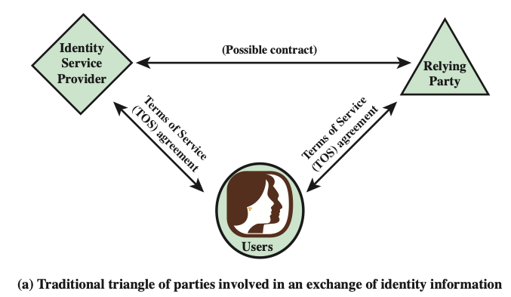
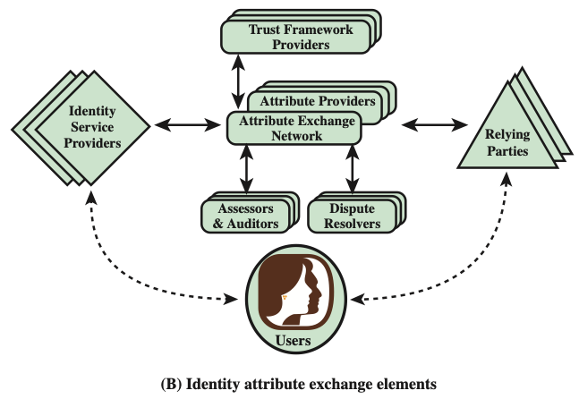
Identity Information Exchange Approaches
OpenID
An open standard that allows users to be authenticated by certain cooperating sites using a third-party service
Notes:
Online or network transactions involving parties from different organizations, or
between an organization and an individual user such as an online customer, generally
require the sharing of identity information. This information may include a host
of associated attributes in addition to a simple name or numerical identifier. Both
the party disclosing the information and the party receiving the information need
to have a level of trust about security and privacy issues related to that information.
Figure 4.13a shows the traditional technique for the exchange of identity information.
This involves users developing arrangements with an identity service provider
to procure digital identity and credentials, and arrangements with parties that
provide end-user services and applications and that are willing to rely on the identity
and credential information generated by the identity service provider.
The arrangement of Figure 4.13a must meet a number of requirements. The
relying party requires that the user has been authenticated to some degree of assurance,
that the attributes imputed to the user by the identity service provider are
accurate, and that the identity service provider is authoritative for those attributes.
The identity service provider requires assurance that it has accurate information
about the user and that, if it shares information, the relying party will use it in
accordance with contractual terms and conditions and the law. The user requires
assurance that the identity service provider and relying party can be entrusted with
sensitive information and that they will abide by the user’s preferences and respect
the user’s privacy. Most importantly, all the parties want to know if the practices
described by the other parties are actually those implemented by the parties, and
how reliable those parties are.
Without some universal standard and framework, the arrangement of Figure 4.13a
must be replicated in multiple contexts. A far preferable approach is to develop an
open, standardized approach to trustworthy identity and attribute exchange. In the
remainder of this section, we examine such an approach that is gaining increasing
acceptance.
Unfortunately, this topic is burdened with numerous acronyms, so it is best to
begin with a definition of the most important of these:
• OpenID: This is an open standard that allows users to be authenticated by certain
cooperating sites (known as Relying Parties) using a third party service,
eliminating the need for Webmasters to provide their own ad hoc systems and
allowing users to consolidate their digital identities. Users may create accounts
with their preferred OpenID identity providers, and then use those accounts as
the basis for signing on to any website which accepts OpenID authentication.
Figure 4.13b shows the elements involved in the OITF. Within any given organization
or agency, the following roles are part of the overall framework:
• Relying parties (RPs): Also called service providers, these are entities delivering
services to specific users. RPs must have confidence in the identities and/or
attributes of their intended users, and must rely upon the various credentials
presented to evince those attributes and identities.
• Subjects: These are users of an RP’s services, including customers, employees,
trading partners, and subscribers.
• Attribute providers (APs): APs are entities acknowledged by the community
of interest as being able to verify given attributes as presented by subjects
and which are equipped through the AXN to create conformant attribute credentials
according to the rules and agreements of the AXN. Some APs will
be sources of authority for certain information; more commonly APs will be
brokers of derived attributes.
• Identity providers (IDPs): These are entities able to authenticate user credentials
and to vouch for the names (or pseudonyms or handles) of subjects, and
which are equipped through the AXN or some other compatible Identity and
Access Management (IDAM) system to create digital identities that may be
used to index user attributes.
There are also the following important support elements as part on an AXN:
• Assessors: Assessors evaluate identity service providers and RPs and certify
that they are capable of following the OITF provider’s blueprint.
• Auditors: These entities may be called on to check that parties’ practices have
been in line with what was agreed for the OITF.
• Dispute resolvers: These entities provide arbitration and dispute resolution
under OIX guidelines.
• Trust framework providers: A trust framework provider is an organization
that translates the requirements of policymakers into an own blueprint for a
trust framework that it then proceeds to build, doing so in a way that is consistent
with the minimum requirements set out in the OITF specification. In
almost all cases, there will be a reasonably obvious candidate organization to
take on this role, for each industry sector or large organization that decides it
is appropriate to interoperate with an AXN.
The solid arrowed lines in Figure 4.13b indicate agreements with the trust
framework provider for implementing technical, operations, and legal requirements.
The dashed arrowed lines indicate other agreements potentially affected
by these requirements. In general terms, the model illustrated in Figure 4.13b
would operate in the following way. Responsible persons within participating
organizations determine the technical, operational, and legal requirements for
exchanges of identity information that fall under their authority. They then select
OITF providers to implement these requirements. These OITF providers translate
the requirements into a blueprint for a trust framework that may include additional
conditions of the OITF provider. The OITF provider vets identity service
providers and RPs and contracts with them to follow its trust framework requirements
when conducting exchanges of identity information. The contracts carry
provisions relating to dispute resolvers and auditors for contract interpretation
and enforcement.

Slide 110
OAuth 2.0 Intro.
OAuth 2 is an authorization framework that enables applications — such as Facebook, GitHub, and DigitalOcean — to obtain limited access to user accounts on an HTTP service.
It works by delegating user authentication to the service that hosts a user account and authorizing third-party applications to access that user account.
OAuth 2 provides authorization flows for web and desktop applications, as well as mobile devices.

Slide 111
OAuth Roles
OAuth defines four roles:
Resource Owner: The resource owner is the user who authorizes an application to access their account. The application’s access to the user’s account is limited to the scope of the authorization granted (e.g. read or write access)
Client: The client is the application that wants to access the user’s account. Before it may do so, it must be authorized by the user, and the authorization must be validated by the API.
Resource Server: The resource server hosts the protected user accounts.
Authorization Server: The authorization server verifies the identity of the user then issues access tokens to the application.

Slide 112
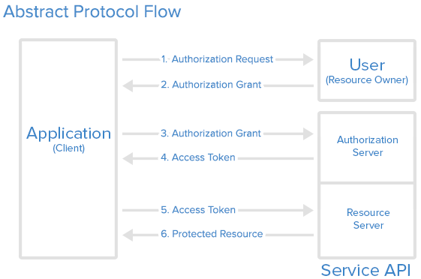
OAuth Steps

Slide 113
OAuth service steps
Application Registration
Application Name
Application Website
Redirect URI or Callback URL
Authorization Grant – Various Types
Authorization Code: used with server-side Applications
Client Credentials: used with Applications that have API access
Device Code: used for devices that lack browsers or have input limitations

Slide 114
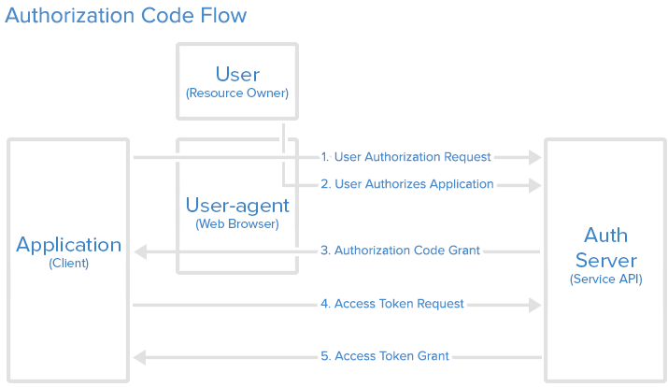
Most used Grant Type: Authorization Code

Slide 115
Network Scanning and Vulnerability Scanning
Digital Forensics
Cybersecurity Engineering
Security policies
Firewalls
Authentication, Access controls
Federated trust
IoT/Cloud middleware
Module 4 – Defense Architectures and Design

Slide 116
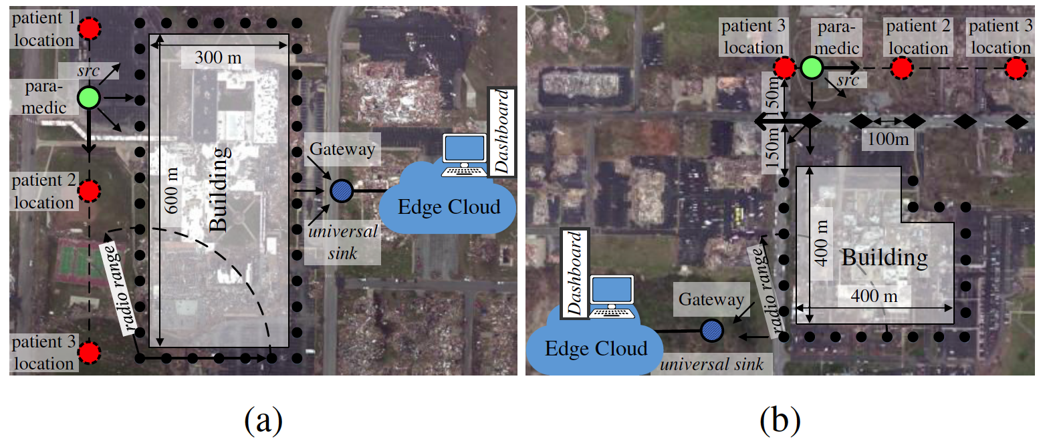
Lightweight and Flexible Security for IoT-based Smart City Applications
Recreated disaster scenes of tornado damages (in Joplin, MO 2011) at the: (a) Joplin High School; (b) Joplin Hospital

Slide 117
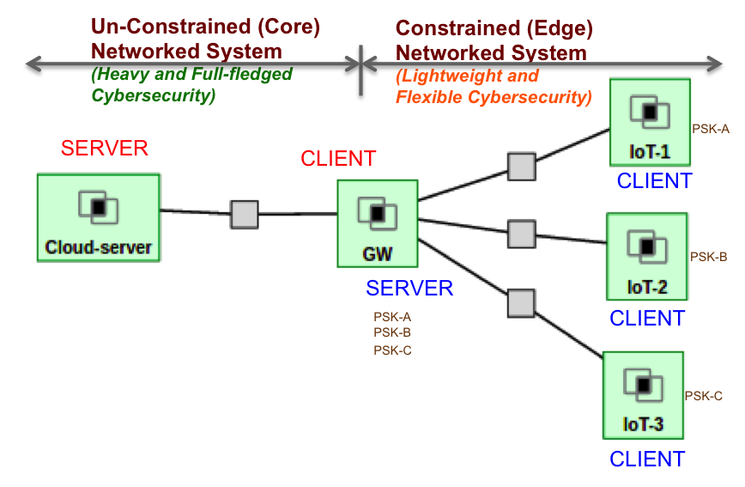
Lightweight and Flexible Security for IoT-based Smart City Applications
IoT Gateway Middleware that uses machine learning to decide on tradeoffs in energy, latency and security in deciding computing policies at core or edge
B. Mukherjee, S. Wang, W. Lu, R. Neupane, D. Dunn, Y. Ren, Q. Su, P. Calyam, “Flexible IoT Security Middleware for End-to-End Cloud-Fog Communication”, Elsevier Future Generation Computer Systems (FGCS) – Special Issue on Internet of Things (IoT): Operating System, Applications and Protocols Design, and Validation Techniques, 2018.

Slide 118
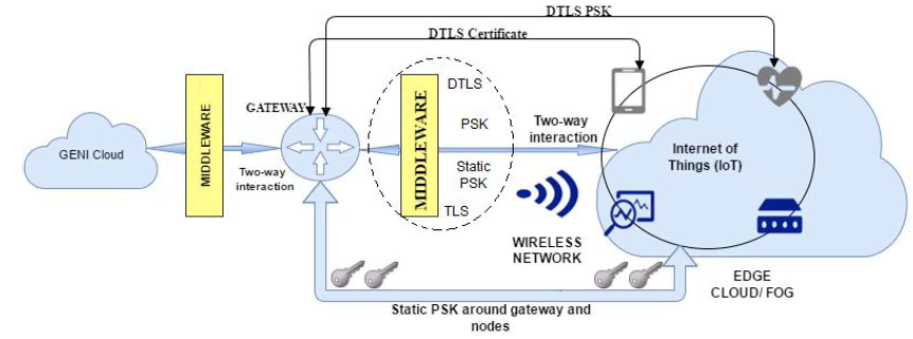
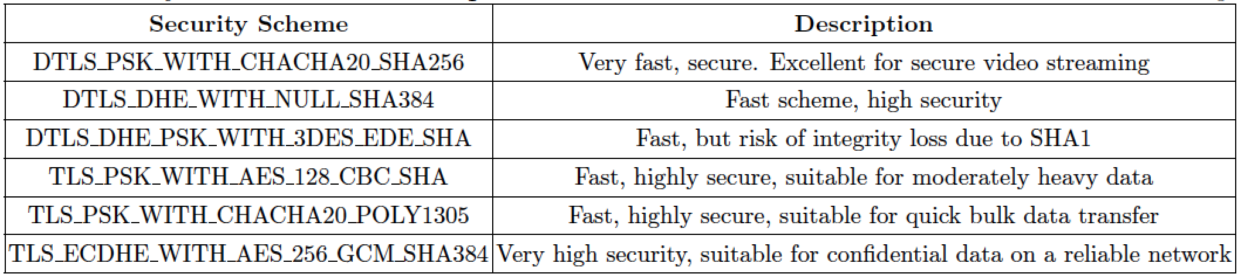
Resource-aware IoT Security Middleware for End-to-End Cloud-Fog Communication
Gateway-hosted middleware stores and tracks sessions, certificates or keys between the fog and cloud entities
Decouples services and protocols for end-to-end security using static pre-shared keys for quick encryption setup
Selection of security protocols to be used based on resource-awareness

